Slide 1








IHE-HL7 Gemini SES+MDI – From Use Cases to Test Reports – 2022 RI+MC+RR Strategy
Updated: 2022.05.13
FHIR is a trademark of Health Level 7, International.
SDC is a registered trademark of OR.NET

Slide 2
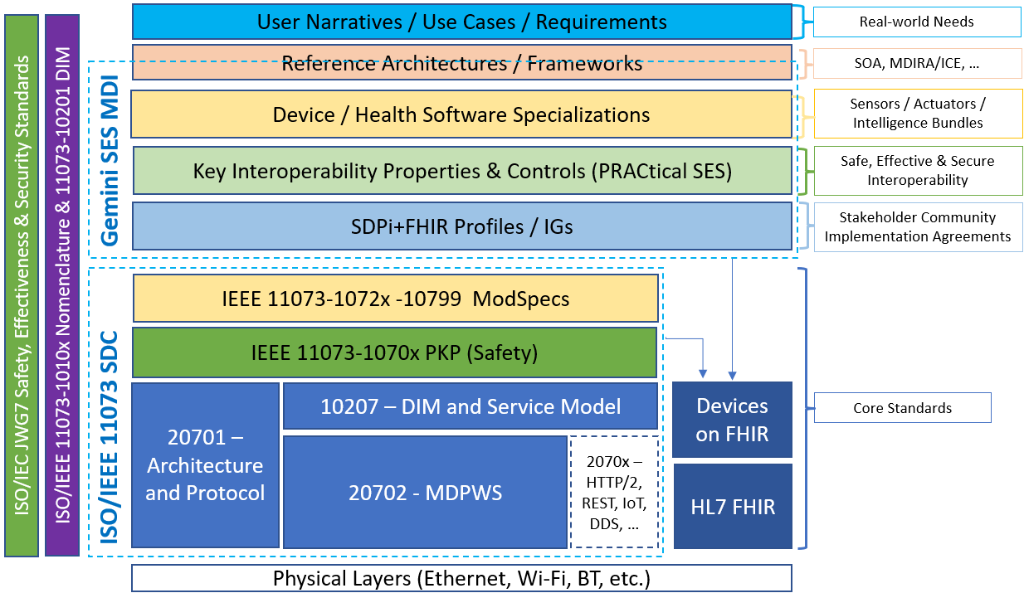
Gemini SES+MDI From Use Cases to Test Reports 2022 RI+MC+RR Strategy
Landscape Outlook for SDPi Specification & Testing in 2022
SDPi 1.0 – RI+MC – Basic Support
SDPi 1.0 – Testing & CA & Tooling – Basic Support
Possibilities but not Probabilities but .. Opportunities?!

Slide 3
Gemini SES+MDI – 2022 RI+MC+RR Strategy – Landscape Outlook for SDPi Specification & Testing in 2022
With a goal of publishing the SDPi 1.0 in 2022-Q2 and achieving first IHE CAT testing before the end of 2022 … and given the realities of what we have NOW vs. our long-term vision for RI+MC+RR … what’s the near-term strategy?

Slide 4
SDPi 1.0 Spec-to-Test – ‘22 Landscape Realities
2022 Landscape realities …
Gemini SES+MDI Vision is solid
Requirements Interoperability + Model Centric + Regulatory Ready Aspirations … are solid
Increased testing rigor from messages to semantics to clinical context/function … is solid
3-Year Roadmap & SDPi 1.0 “Basic” Capabilities + Testing Targets are settled … clock is ticking!
Gazelle is what it is … today … Cannot wait for evolution to NextGen platform for SDPi 1.0
IHE Test Plan / Case formalization & script automation … remain mostly undefined
Support for HL7 FHIR-based IHE Profiles & Testing … has “taken the oxygen out of the room”
MedTech community of interest – esp. SES … just starting to get momentum
Work teams are established – SDPi Tech, Ecosystem Pathway, CA & Tooling … we are it!
MS Word based specifications remain the best path forward … but “toward MC” can be started

Slide 5
SDPi 1.0 Spec-to-Test – ‘22 Landscape Realities
Good News!!!
Working within these landscape realities…
‘22 Gemini SES+MDI Roadmap
“Basic” SDPi 1.0 can be
successfully achieved

Slide 6
Gemini SES+MDI – 2022 RI+MC+RR Strategy – SDPi 1.0 – RI+MC – Basic Support
Given the landscape before us at the start of 2022, what can we realistically achieve for advancing the requirements interoperability and model centric initiatives? What does “basic support” look like?

Slide 7
SDPi 1.0 & RI+MC – “Basic” Support
What does SDPi 1.0 “Basic” Support look like?
SDPi 1.0 Specification –
Word-based – > 200 page supplement “skeleton” already crafted
Publish as PDF (traditional) – optionally HTML via NIST V2plus Tooling (adapted)
2022 Capabilities identified in the roadmap are detailed in the TF supplement
Requirements Interoperability –
RI UML Model linked to Word constructs (Styles / Bookmarks / Links)
Requirements sources modeled: Use Cases + Ref’d Standards + SES/RM + Tech Specific
Requirements flow established: TF-1 Appendix B & C to TF-1, TF-2 & TF-3 elements
Model Centric –
Basic UML Model for RI + Testing Elements … perhaps incl. modeled IHE TF elements
NIST tooling (for V2plus) leveraged to create initial “single source of truth” database

Slide 8
SDPi 1.0 & RI+MC – “Basic” Support
What does SDPi 1.0 “Basic” Support look like?
Regulatory Ready / CA & Tooling –
Test plans / cases incl. content as for previous profiles … but maintained external to test tooling
IHE PAT events leveraged to continue test tooling & test cases / scripts development
Manually integrate into Gazelle … as for previous profiles
Test plan / case information and linkages integrated into SST Database for basic RI –
traceability & coverage from test cases to requirement sources

Slide 9
Gemini SES+MDI – 2022 RI+MC+RR Strategy – SDPi 1.0 – Testing & CA & Tooling – Basic Support
With basic support for RI+MC in hand, how might we advance “RR” – regulatory submission ready – test reports? Given the early 2022 testing and tooling landscape, how can test plans, scripts, Gazelle test management, SDC/SDPi tooling be leveraged to provide basic support for IHE Connectathon events … in 2022?

Slide 10
From Specs to Test Reports – ”Basic” Strategy
Word Styles / Bookmarks / Links
Basic RI+MC+RR UML Model
Gazelle Test Management Tool
SDPi 1.0
Specification
Used to create DB schema
Basic test instance metadata provided to Test Tool … somehow
Content integrated manually …
“The Old Fashioned Way”!
“Simple” Word Docx
Michael’s Amazing Word-to-Database Transformation Tool
SDC/SDPi Test Tool
Test Script Info
Report document “attached” to test instance and reviewed by Monitor
SDPi RI+MC+RR Database
Driven by Use Cases, Standards Conformance, SES & Tech Requirements
Generated by tool w/ test instance metadata integrated
SDPi 1.0
Test Plans & Scripts
Test Case (Instance) Report
“Single Source of Truth”
Links from test plans / scripts to RI elements (enabling traceability / coverage)
Crafted & Maintained Independent of
Test Tooling
Legend
Automated
Manual / Semi-auto
“RR” Report – Supporting Evidence

Slide 11
Spec-to-Test Strategy – RI+MC+RR Model
Basic RI+MC+RR UML Model
“Basic” Requirements Interoperability Model for SDPi 1.0 Document:
Word Constructs:
Style
Link
Bookmark
Need standardized language / conventions for “Requirement” specification
SDPi Requirement
link
Capability
0..*
0..*
“is a”
1..1
0..1
0..1
0..1
Use Case
Ref. Standard ICS
SES
Technology
Capability provides implementation for Requirements
Considerations / Homework:
Word references / links require “bookmarks” – set places in the document (see also PKP examples)
Word “styles” will require some naming method of each style / link / Bookmark to ensure continuity
“Capability” Types needed?
Identifiers / nomenclature required? SDPi Rxxxx? “Link” text?
Create examples for each, including Text in Word + Word XML rendering
Bidirectional navigation? Unidirectional (req to capability) sufficient? (Note: 0..* simply indicates that each end can be linked to / from multiples on the other side of the relationship)

Slide 12

Spec-to-Test Strategy – RI+MC+RR Model
Basic RI+MC+RR UML Model
ReqIF Example: Requirement related to System Function Contribution
<w:p w14:paraId="5672C5E0" w14:textId="77777777" w:rsidR="00743536" w:rsidRDefault="000A5E66">
<w:pPr> <w:pStyle w:val="IEEEStdsParagraph"/> <w:jc w:val="left"/> </w:pPr>
<w:bookmarkStart w:id="123" w:name="Requirement:R0062"/>
<w:r> <w:rPr> <w:b/> </w:rPr> <w:t>R0062</w:t> </w:r>
<w:bookmarkEnd w:id="123"/>
<w:r> <w:rPr> <w:b/> </w:rPr>
<w:t>: If an SDC PARTICIPANT produces EXCESSIVE LOAD CONDITIONs, each SDC PARTICIPANT that is affected by these conditions SHALL maintain its SYSTEM FUNCTION CONTRIBUTIONs for other SDC PARTICIPANTs.</w:t>
</w:r>
</w:p>
IEEE p11073-10700
(Draft 1 – Under the Hood)
IEEE p11073-10700
(Draft 1)
Observation: ReqIF Used for Document Creation – Not requirements formalization!

Slide 13
Spec-to-Test Strategy – RI+MC+RR Model
Basic RI+MC+RR UML Model
SDPi 1.0
Test Plans & Scripts
“Basic” Requirements Interoperability Model for Test Plans/Cases:
SDPi RI+MC+RR Database
Note: Model for early discussion purposes only (not formal UML!)
0..*
0..*
SDPi Requirement
link
Capability
Test Assertion
0..*
Test Plan
0..*
0..*
1..*
0..*
0..*
1..*
1..1
Word-based Specification
Test Plan-Scenario Context Information
1..*
1..1
Test Scenario
1..*
Test Scenario Execution Report
Considerations / Homework:
Test Assertion to Test Scenario key to RI
Cardinalities? (Navigation? is it 1:1 or 1..*)
Test Assertions are external to Word spec. – SST DB or Separate File?
…
Test Plan Execution Report

Slide 14
Spec-to-Test Strategy – RI+MC+RR Model
Basic RI+MC+RR UML Model
SDPi 1.0
Test Plans & Scripts
“Basic” Requirements Interoperability Model for Test Plans/Cases:
SDPi RI+MC+RR Database
Note: Model for early discussion purposes only (not formal UML!)
0..*
0..*
SDPi Requirement
link
Capability
Test Assertion
0..*
Test Plan
0..*
0..*
1..*
0..*
0..*
1..*
1..1
Test Plan-Scenario Context Information
1..*
1..1
Test Scenario
1..*
Test Scenario Execution Report
Relationships & Cardinalities & Hierarchies:
Model should scale – simple to complex: 0..*
REQ–CAP–TA … independent hierarchies
REQ–CAP–TA … links can be at appropriate level
TA–CAP typically 1:1 but may (future?) be 1..*
TA points to CAP (1:1) – assertions external to Word spec
0..* relationships may require business rule / constraint
Test Plan Execution Report
Note: NIST Asbestos requires a FHIR Extension to support modular / hierarchical Test Assertions

Slide 15
Spec-to-Test Strategy – RI+MC+RR Model
Basic RI+MC+RR UML Model
SDPi 1.0
Test Plans & Scripts
“Basic” Requirements Interoperability Model for Test Plans/Cases:
SDPi RI+MC+RR Database
Note: Model for early discussion purposes only (not formal UML!)
0..*
0..*
SDPi Requirement
link
Capability
Test Assertion
0..*
Test Plan
0..*
0..*
1..*
0..*
0..*
1..*
1..1
Test Plan-Scenario Context Information
1..*
1..1
Test Scenario
1..*
Test Scenario Execution Report
From Test Plans to “RR” Reports:
Model is generalized – see GMM for specifics
Test Plans may also need to be “modular” (aggregation not shown)
Context identifies test execution info (e.g., real systems)
Each test execution instance artifacts (with UID & context)
Test Scenario Execution Report is attached to a Gazelle test instance for monitor review
Test Plan Execution Report supports “regulatory submission ready”
Test Plan Execution Report

Slide 16
Spec-to-Test Strategy – RI+MC+RR Model Notes
Basic RI+MC+RR UML Model
SDPi 1.0
Test Plans & Scripts
Questions supported by the modeling approach:
Navigation (traceability) from SUT test reports to requirements coverage?
Coverage of referenced standards requirements? (e.g., 11073-10701)
Linkages supported at the right touch points between the REQ-CAP-TA-TS hierarchies?
Independence and modularity supported by REQ/CAP/TA/TS/TP for improved long term maintenance and evolution?
…
SDPi RI+MC+RR Database
Rationale for modeling approach:
Level of modeling abstraction sufficient to cover subsequent slide detail BUT not fully “baked” implementable UML specifications
“Context Information” may be both static across all scenarios as well as scenario specific (e.g., group tests vs. “no peer” tests)
Test Plan & Test Scenario Execution Reports include execution context information instance artifacts, as shown on the model via the Test Scenario object
Test Plans may be modular, supporting (aggregation relationship not shown)
TA & CAP may only require “leaf” node links – business rule may be required
TA may require support of sub-assertions (e.g., for implementation platform differences) but that do not necessarily map directly to a CAP – a business rule may be needed to make this clear

Slide 17
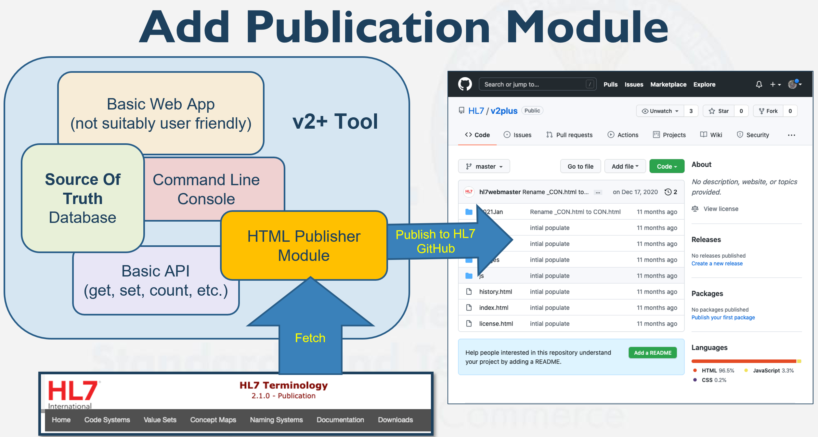
Spec-to-Test Strategy – SDPi 1.0 Specification
SDPi 1.0
Specification
Word doc integrating “basic” RI+MC+RR support (see preceding slides)
Constrained to roadmap capabilities
Published as PDF (traditional)
Supporting RI import to database
(See next slide)
Pilot Goal: HTML Publication
(may require integration of IHE TF elements to UML model – beyond “basic” RI+MC+RR)
Source: Michael Faughn 2022 January WGM Update / V2plus Project

Slide 18
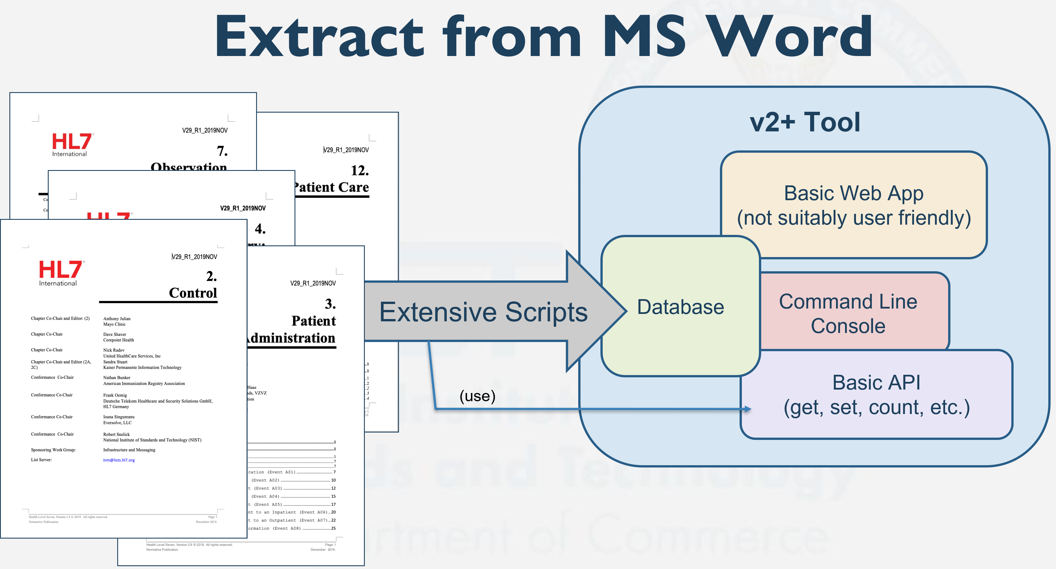
Spec-to-Test Strategy – To a SST Database
Word Styles / Bookmarks / Links
Basic RI+MC+RR UML Model
SDPi 1.0
Specification
Used to create DB schema
“Simple” Word Docx
Michael’s Amazing Word-to-Database Transformation Tool
SDPi RI+MC+RR Database
“Single Source of Truth”
Road to an SDPi 1.0
Single Source of Truth Database:
Source: Michael Faughn 2022 January WGM Update / V2plus Project
Build SDPi 1.0 Word document w/ content aligned to basic RI+MC(+RR) UML model
Utilize UML Model to create database schema
Utilize “Extensive Scripts” to extract content from Word documents to Database

Slide 19
Spec-to-Test Strategy – To Test Plans / Scripts
SDPi 1.0
Test Plans & Scripts
<see UML models preceding slide #13>
Format?
Content organization?
Access / automation?
Plans vs. Cases? Sets of cases called … ?
Review Gazelle Test Management guide
Review Steve Moore’s IPS testing docs
Review FHIR TestScript … ???
Automation platforms … best guess of format today?

Slide 20
Spec-to-Test Strategy – Gazelle support today?
Gazelle Test Management Tool
SDPi 1.0
Test Plans & Scripts
Questions:
Test Plan Formalization?
Test Case Formalization?
Language for Gazelle API 1.0? (Catalyst Study Provided?)
https://gazelle.ihe.net/gazelle-documentation/Gazelle-Master-Model/user.html
https://gazelle.ihe.net/gazelle-documentation/Assertion-Manager/user.html
Gazelle Master Model (GMM): Overview (ihe.net)
https://gazelle.ihe.net/gazelle-documentation/Test-Management/user.html

Slide 21
Spec-to-Test Strategy – To Gazelle Integration
Gazelle Master Model (GMM) –
GMM content leveraged by all instances of the test management tool
All profile & test information entered manually via GMM UX
Gazelle Test Management Tool
1..1
Profile
AIPO
1..*
1..*
SDPi 1.0
Test Plans & Scripts
Actor / Integration Profile / Profile Option “Tuple”
1..*
1..1
2..*
1..*
Actors
link
Transactions
1..*
1..*
Test Summary
1..1
Gazelle Test Definitions –
Consists of four components (detail on following slides)
GMM Test elements must be mapped from
Test automation mostly external to Gazelle TM/GMM
Note: Actors & Transactions are Profile independent
Question: “link” cardinality 2..2 or 1..* or … ???
Question: “links” are also “initiator” & “consumer”
Test Description
1..1
Test Definition
Test Roles
1..*
1..*
1..2
Steps
1..*
{ordered}
Source: GMM User’s Guide

Slide 22
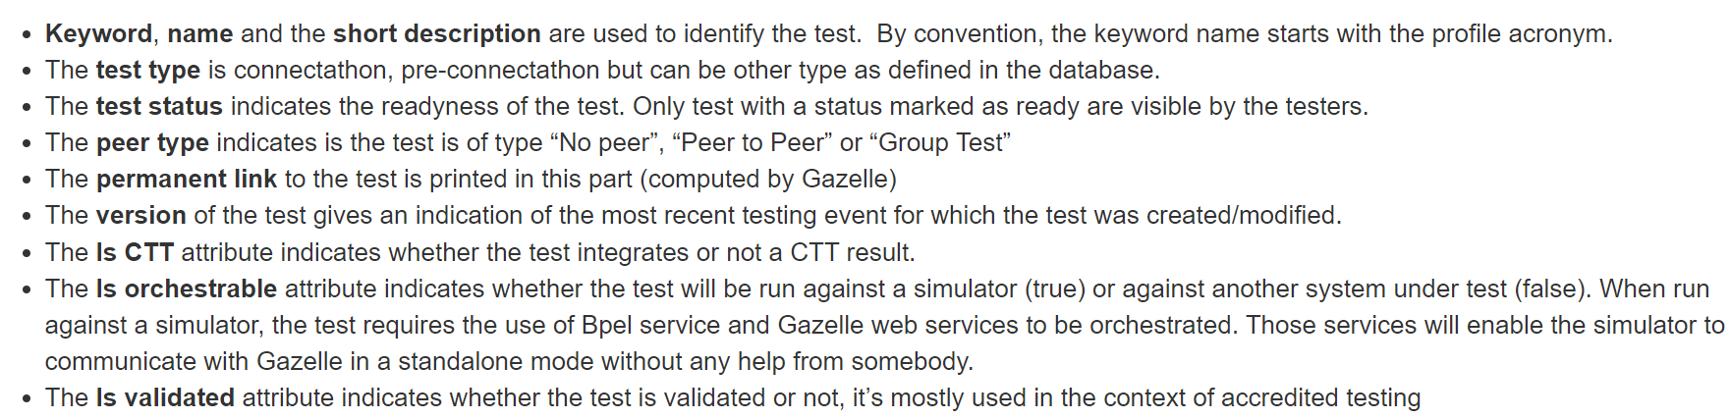
Spec-to-Test Strategy – To Gazelle Integration
Gazelle Test Management Tool
Test Summary
1..1
Test Description
1..1
Test Definition
1..2
Test Roles
1..*
SDPi 1.0
Test Plans & Scripts
Steps
1..*
{ordered}
Source: GMM User’s Guide

Slide 23
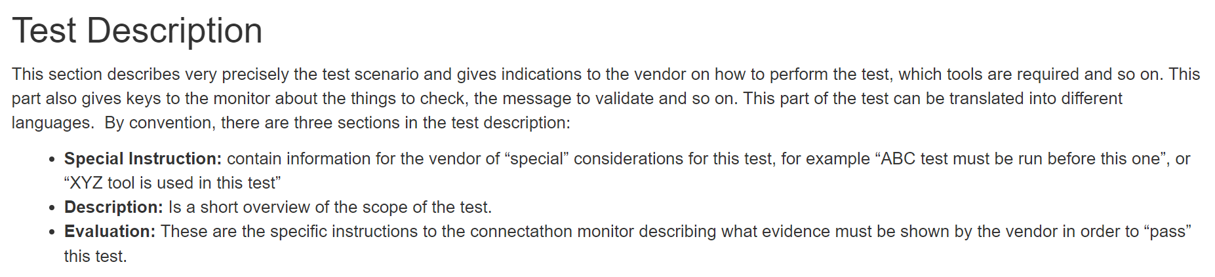
Spec-to-Test Strategy – To Gazelle Integration
Gazelle Test Management Tool
Test Summary
1..1
Test Description
1..1
Test Definition
1..2
Test Roles
1..*
SDPi 1.0
Test Plans & Scripts
Steps
1..*
{ordered}
Source: GMM User’s Guide

Slide 24
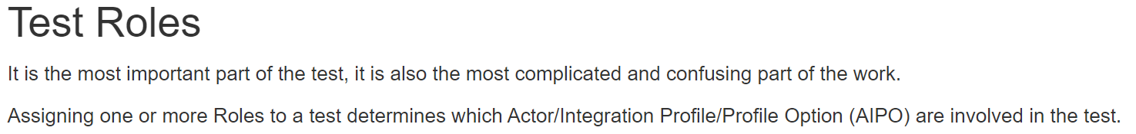
Spec-to-Test Strategy – To Gazelle Integration
Gazelle Test Management Tool
AIPO
Test Summary
1..1
1..*
Actor / Integration Profile / Profile Option “Profile”
Test Description
1..1
Test Definition
1..2
Test Roles
1..*
SDPi 1.0
Test Plans & Scripts
Steps
1..*
{ordered}

Slide 25
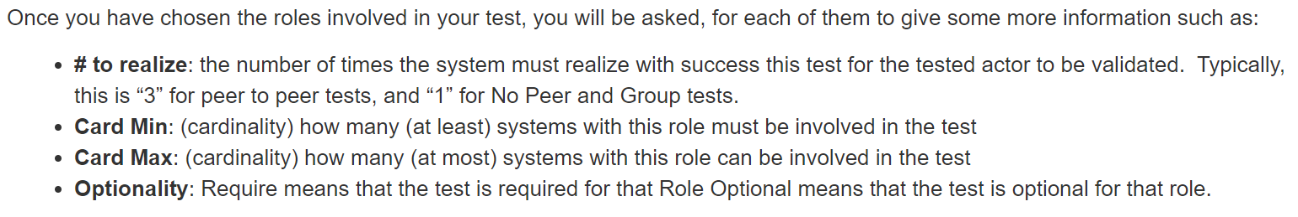
Spec-to-Test Strategy – To Gazelle Integration
Gazelle Test Management Tool
Test Summary
1..1
Test Description
1..1
Test Definition
1..2
Test Roles
1..*
SDPi 1.0
Test Plans & Scripts
Steps
1..*
{ordered}

Slide 26
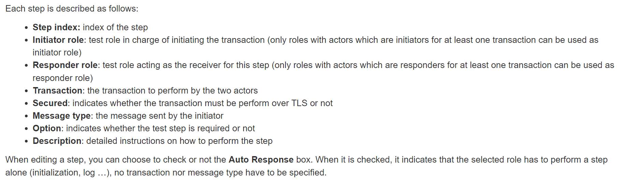
Spec-to-Test Strategy – To Gazelle Integration
Gazelle Test Management Tool
Test Summary
1..1
Test Description
1..1
SDPi 1.0
Test Plans & Scripts
Test Definition
1..2
Test Roles
1..*
Steps
1..*
{ordered}
Source: GMM User’s Guide

Slide 27
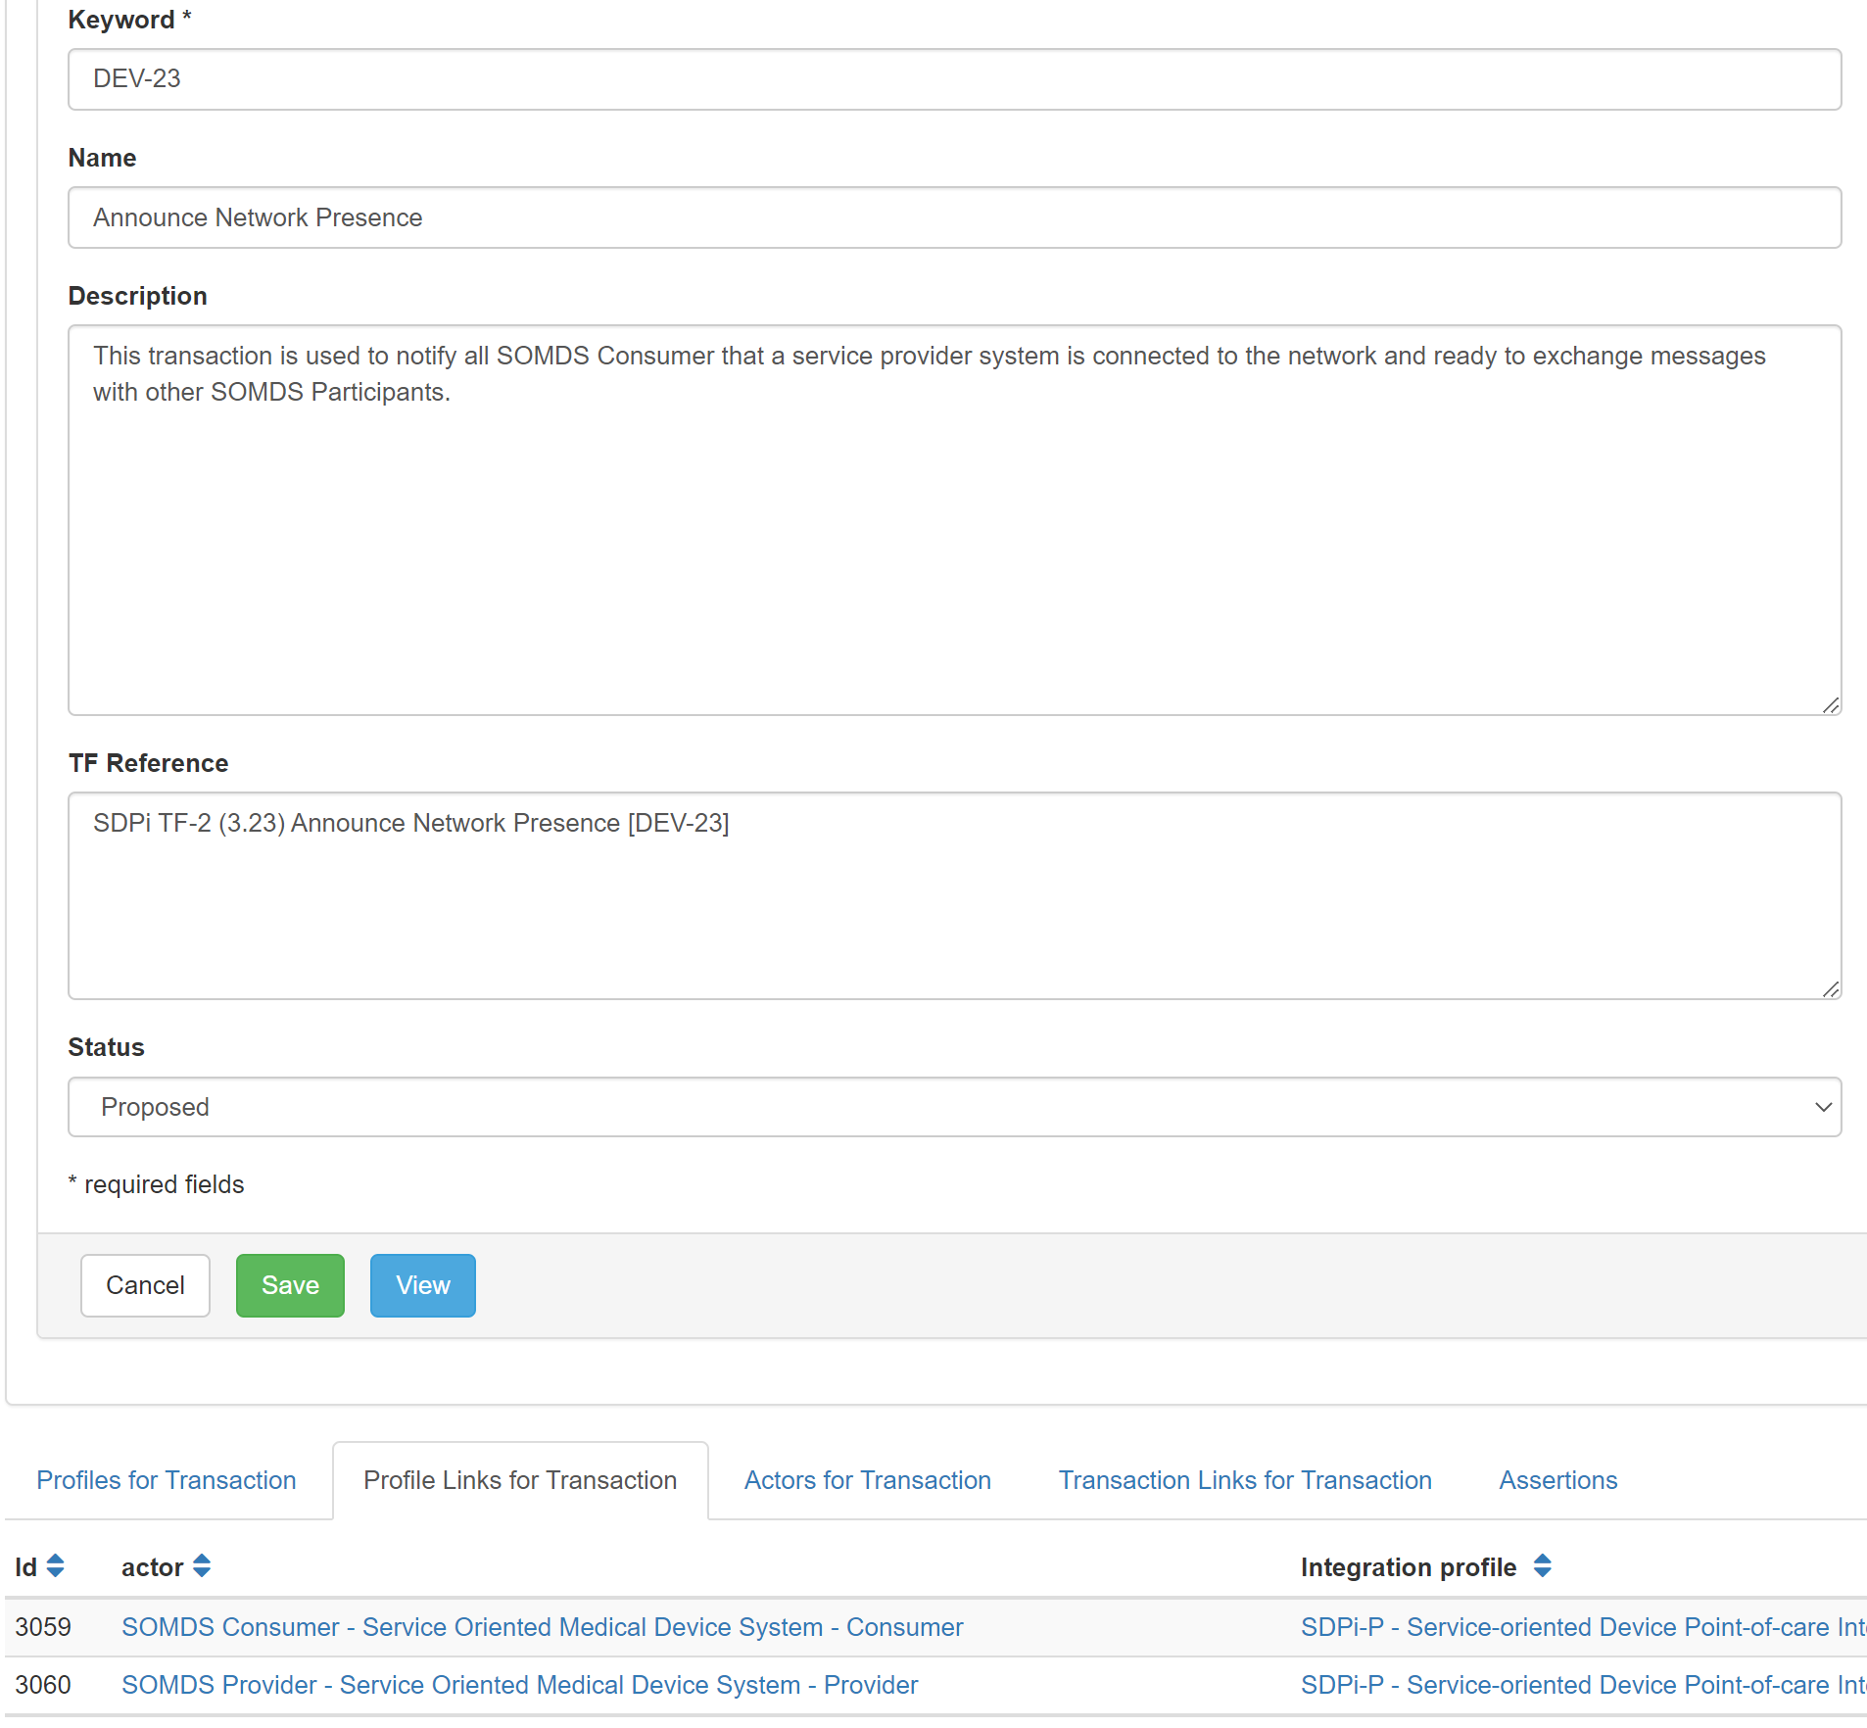
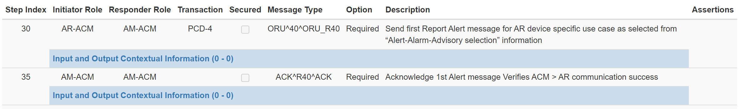
Spec-to-Test Strategy – To Gazelle Integration
Test Summary
1..1
Test Description
1..1
Test Definition
1..2
Test Roles
1..*
Steps
1..*
{ordered}
“Assertions” in Test Steps?

Slide 28
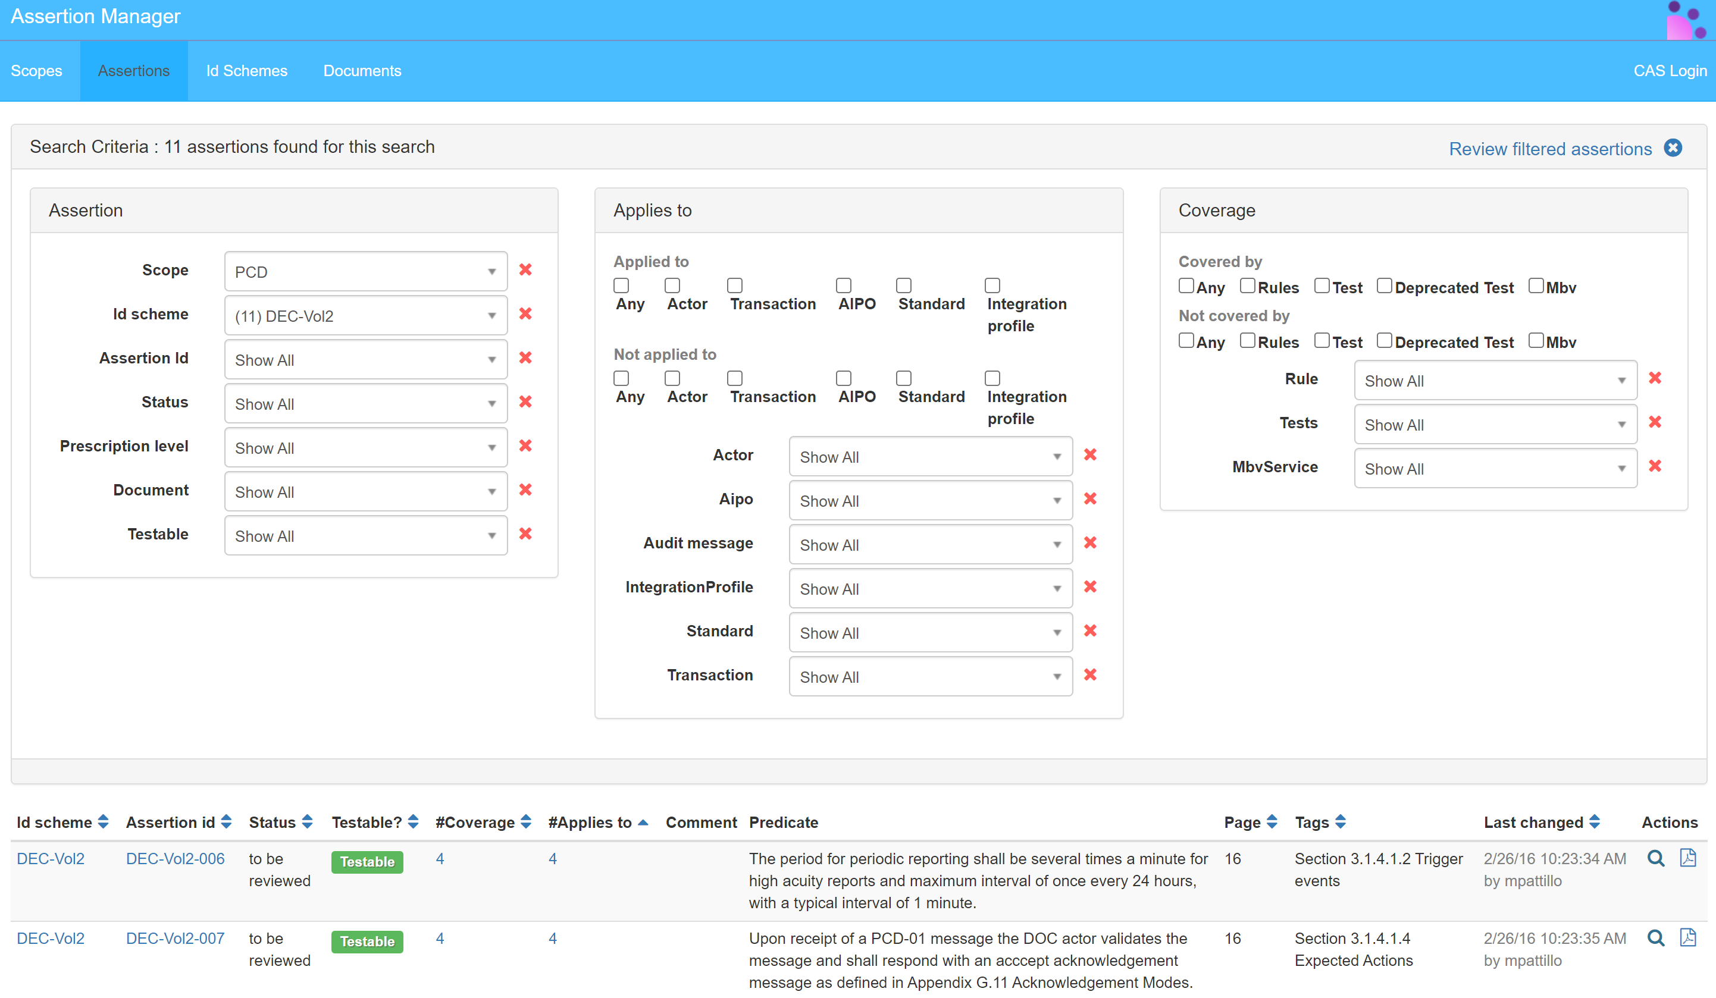
Spec-to-Test Strategy – Gazelle Assertion Manager
Gazelle Assertion Manager Tool–
Primary use is in IHE Conformity Assessment projects (e.g., IHE CAS)
Leverages the OASIS TAML with some custom fields (see next slides)
Assertions can be uploaded to the Assertion Manager in a spreadsheet=>XML file
Assertions can also be pulled into the GMM/TM tools using the Assertion Manager’s REST API
Source: SIA project instance

Slide 29
Spec-to-Test Strategy – Gazelle Assertion Manager
Source: Gazelle X Validator Rule Editor
Gazelle Assertion Manager Tool –
Validator
1..*
IdScheme
TF Rule (constraint)
{one source document}
1..*
1..*
Assertion Coverage
Scope
*
Assertion
*
Test
1..*
1..1 ???
achieved by ???
Test Step
applies to
1..*
Model-Based Validation Service
Actor
AIPO
Integration Profile
Audit Message
Standard
Transaction
Security?
Note: See previous slides for GMM TF / Tests elements + “Assertions in Test Steps?”
AIPO = Actor / Integration Profile / Profile Option tuple
Source: Gazelle Assertion Manager Guide

Slide 30
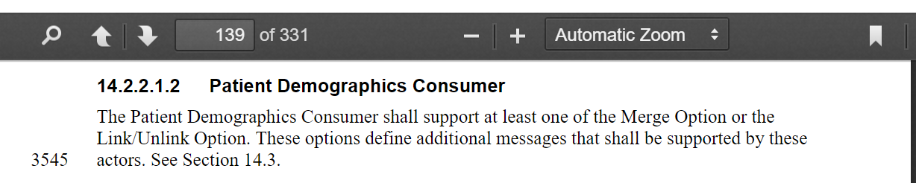
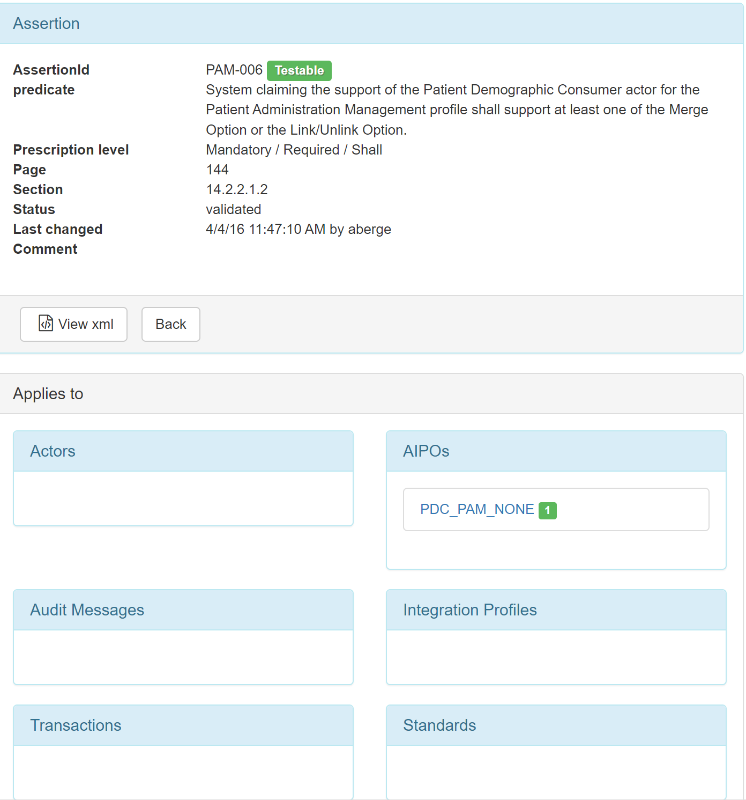
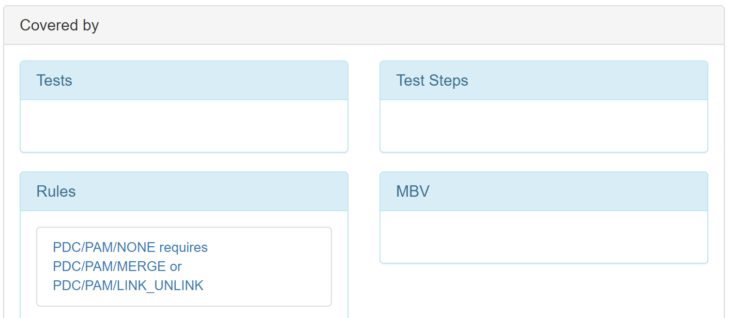
Spec-to-Test Strategy – Gazelle Assertion Manager
Gazelle Assertion Manager Tool – TF Rule Example
See Gazelle X Validator Rule Editor – Definitions section for rule syntax

Slide 31
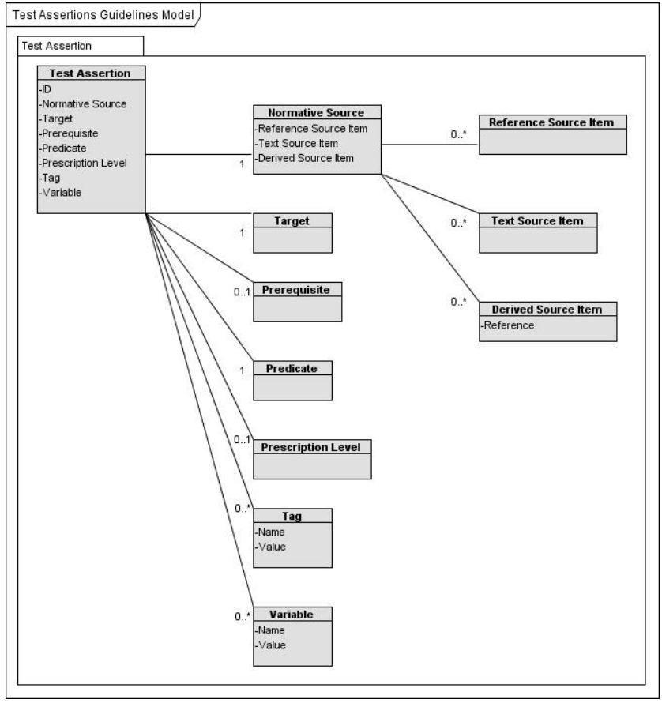
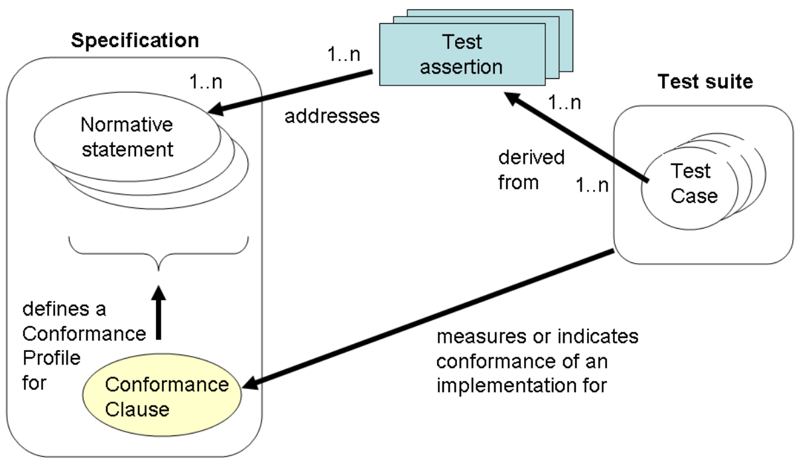
Spec-to-Test Strategy – OASIS TAML
OASIS Test Assertion Markup Language (TAML) –
Leveraged by the Gazelle Assertion Manager Tool
Leveraged by FHIR Test Assertion too … ?
NOTE: Where is a general IHE TF Profile “Conformance Clause”?
1..*
(e.g., SDPi TF-1 Appendix B ICS tables)
OASIS Sources: Test Assertions Part 1 - Test Assertions Model (2009.11.16; v0.2)
Test Assertions Part 2 - Test Assertion Markup Language Version 1.0 (2011.11.30)

Slide 32
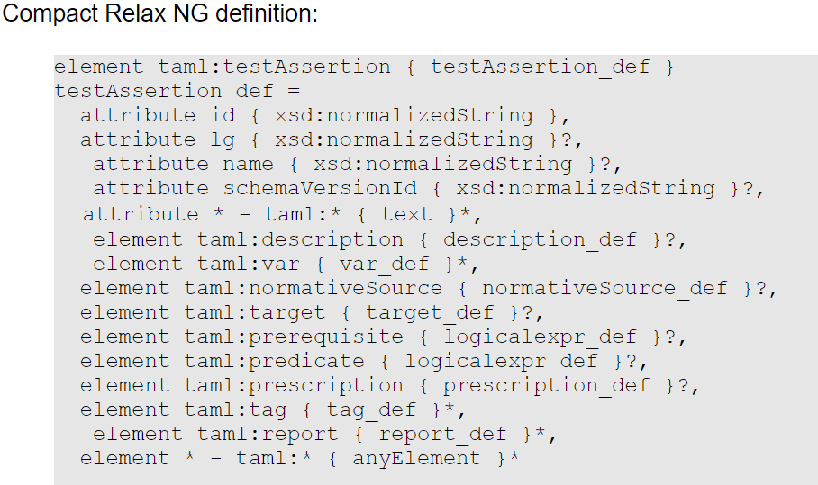
Spec-to-Test Strategy – OASIS TAML
OASIS Test Assertion Markup Language (TAML) –
Part 2 1.0 TAML Specification
1..*
OASIS Sources: Test Assertions Part 1 - Test Assertions Model (2009.11.16; v0.2)
Test Assertions Part 2 - Test Assertion Markup Language Version 1.0 (2011.11.30)

Slide 33
Spec-to-Test Strategy – To SDC/SDPi Tool Integration
Gazelle Test Management Tool
SDC/SDPi Test Tool
Review current SDC Test Tool API (see presentations & github)
Explore with David G. how this might be integrated / automated …
Define requirements / contents for each flow to tool
Can use JUnit format = to PDF to XYZ
Vector Test Tooling?
Automatability is in our court 100%
Automation example like Jenkins plug-in? “Test Complete” s/w suite?
SDPi 1.0
Test Plans & Scripts

Slide 34
Spec-to-Test Strategy – Role of “Vector” Testing?
Gazelle Test Management Tool
SDC/SDPi Test Tool
PAT #7 included participation / presentation by Vector Informatics
What role can this type of testing play in the SDPi Tooling suite?
<do Wikipedia look up for the topic>
SDPi 1.0
Test Plans & Scripts

Slide 35
Spec-to-Test Strategy – To Test Case Reports
Test Case (Instance) Report
Format?
Content organization?
Access?
Show current test report content organization
Propose additional test metadata (supporting Gazelle integration, for example)
CONSIDER FHIR TestReport (subsequent slide)
Include “requirements” for test case report
…

Slide 36
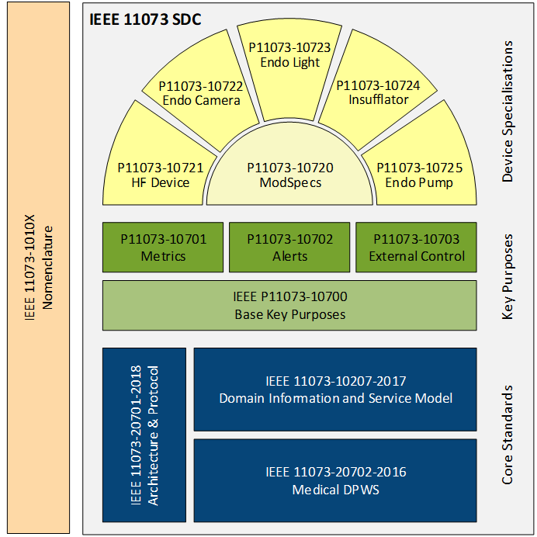
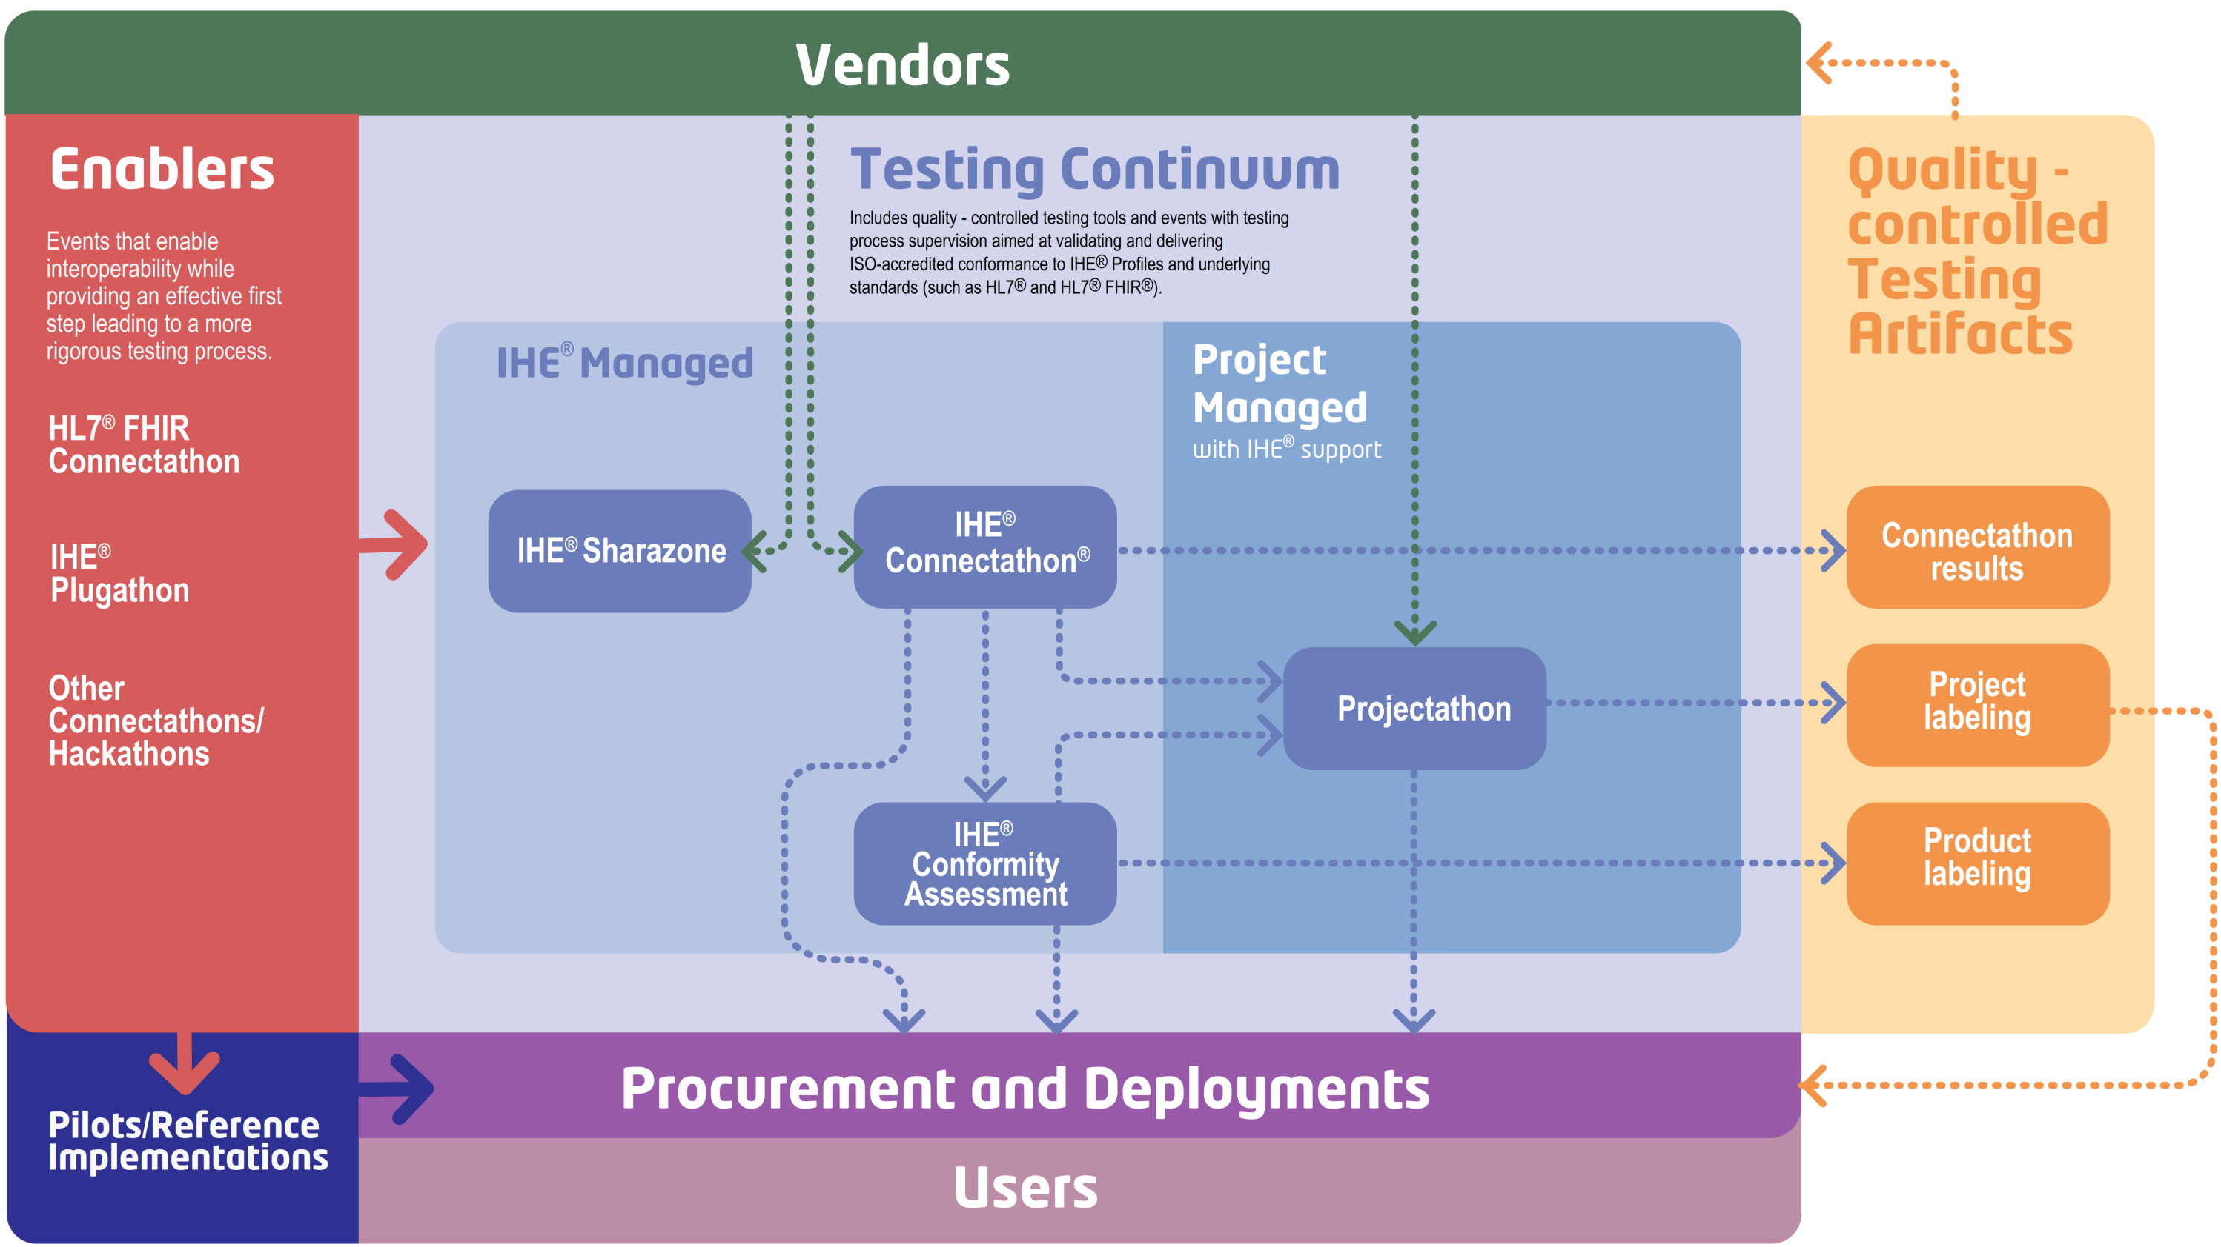
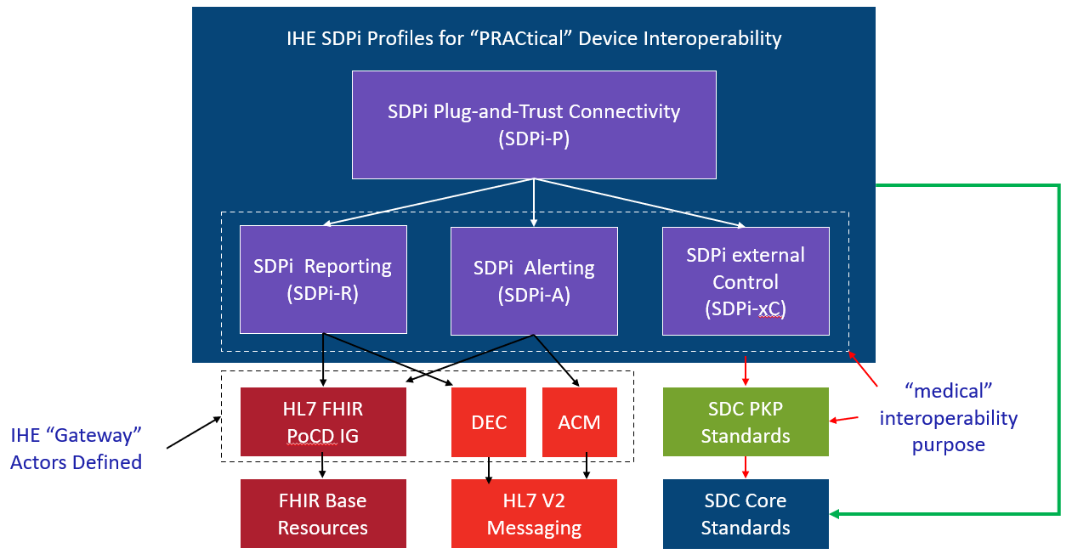
Spec-to-Test Strategy – Closing the Loop / EP Style
Traceability & Coverage back to 11073-1070x PKP ICS Specifications (via “RI”)
IEEE 11073-1070x Project Teams
Gemini SES+MDI Community
CA “RR”
Test Report
Develop
Develop
11073-1070x PKP Standards
IHE SDPi TF Specifications (TF-1 / Appendix B)
SES+MDI SDC/SDPi+FHIR
Test Plans/Scripts + PAT/CAT + Product CA
Require-ments
PKP ICS Tables

Slide 37
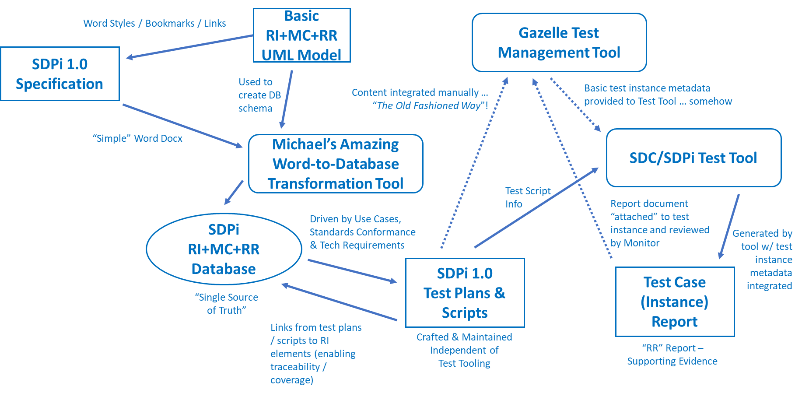
Spec-to-Test Strategy – Closing the Loop?
Pathway without RI+MC+RR Support …
IHE CAT System Test Report
Process is almost entirely manual!
Legend
Automated
Manual / Semi-auto

Slide 38
Spec-to-Test Strategy – Closing the Loop?
Pathway with RI+MC+RR Support …
IHE CAT System Test Report
?
Gemini SES+MDI “RI” Test Report

Slide 39
Spec-to-Test Strategy – “RR” Test Reports?
Traceability & Coverage back to 11073-1070x PKP ICS Specifications (via “RI”)
What is the strategy for getting to a “regulatory submission ready” product CA test report?
IEEE 11073-1070x Project Teams
Gemini SES+MDI Community
CA “RR”
Test Report
Develop
Develop
IHE SDPi TF Specifications (TF-1 / Appendix B)
SES+MDI SDC/SDPi+FHIR
Test Plans/Scripts + PAT/CAT + Product CA
11073-1070x PKP Standards
Require-ments
PKP ICS Tables
Test results currently are persisted in the Gazelle testing / CA database …
Should SDPi 1.0 test report results be incorporated into the SST database to link with RI-to-Test Case information?
Should a separate test results database be created? + A tool that can combine the multi-database content to create a RR CA report?
How are CA test reports created today? Historically? Separate tool from Gazelle? Extended Gazelle instance?

Slide 40
Spec-to-Test Strategy – FHIR “Friendly”?
Does FHIR “TESTING MODEL” fit for purpose / adaptable for use in IHE SDPi testing?
Can MHD’s use of TestScript be leveraged for SDPi Test Script usage? (Note: TS is @ FMM#2)
Note: Asbestos includes an extension to enable modular TAs
What does it mean to be … FHIR “Friendly”?
Can FHIR related testing elements, processes and tooling be fully utilized / borrowed?
Can FHIR TestScript, TestReport, Assert, etc. be the basis for OR “inform” the analogues in SDPi 1.0?
Why should Gemini SES+MDI consider being … FHIR “Friendly”?
Given the identified landscape “realities”, utilizing FHIR elements, though not optimal, could simplify & de-risk achieving support for SDPi 1.0 Testing & CA in 2022
IHE profiles like MHD + IHE Gazelle GMM/TM & tooling already support FHIR constructs like TestScript
FHIR-based SDPi Actors will require support for FHIR testing capabilities – why reinvent the wheel?
No
Is FHIR “Friendly” required for SDPi 1.0?
https://www.hl7.org/fhir/testscript.html
https://www.hl7.org/fhir/testing.html

Slide 41
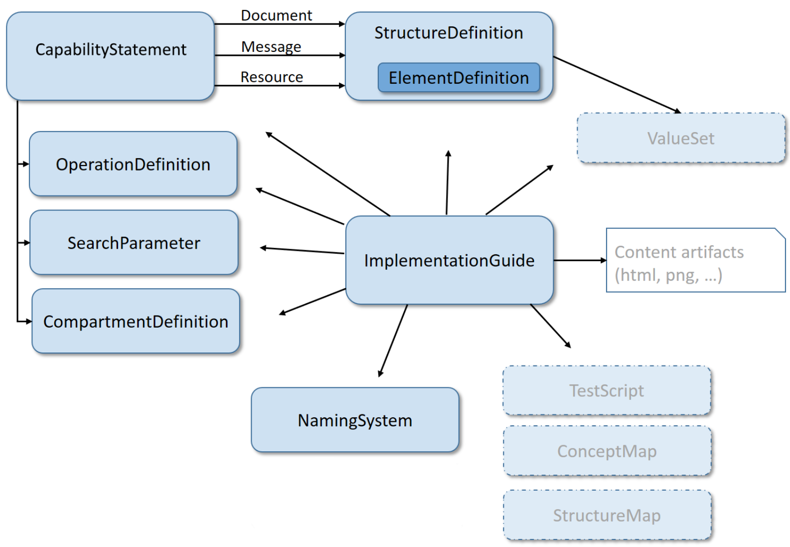
Spec-to-Test Strategy – FHIR Conformance “Friendly”
SEE JOHN MOEHRKE’S EMAIL ABOUT CONFORMANCE resources:
Gazelle tooling supports validation against StructureDefinition’s
IG with (complete) Conformance resources + good examples – Bang!
Use TestScript for the transactional interactions & behaviours
Only MHD has done all this at this point
qa.html should be 0,0,0,0
NOTE: This is relevant to each of the SDPi profiles, in that they include FHIR-enabled actors for three of the core functions (PnT, Reporting, and Alerting)
FHIR Conformance Testing
IS THIS MODEL CORRECT FOR CONFORMANCE RESOURCES CALLOUT?
FHIR (R4) Conformance Module
FHIR (R5) Conformance Module
Firely Conformance Resources
INCLUDE DETAILED SLIDE SHOWING MHD INTEGRATION WITH GMM/TM
IHE MHD Test Plan
INCLUDE DETAILED SLIDE SHOWING MHD APPROACH

Slide 42
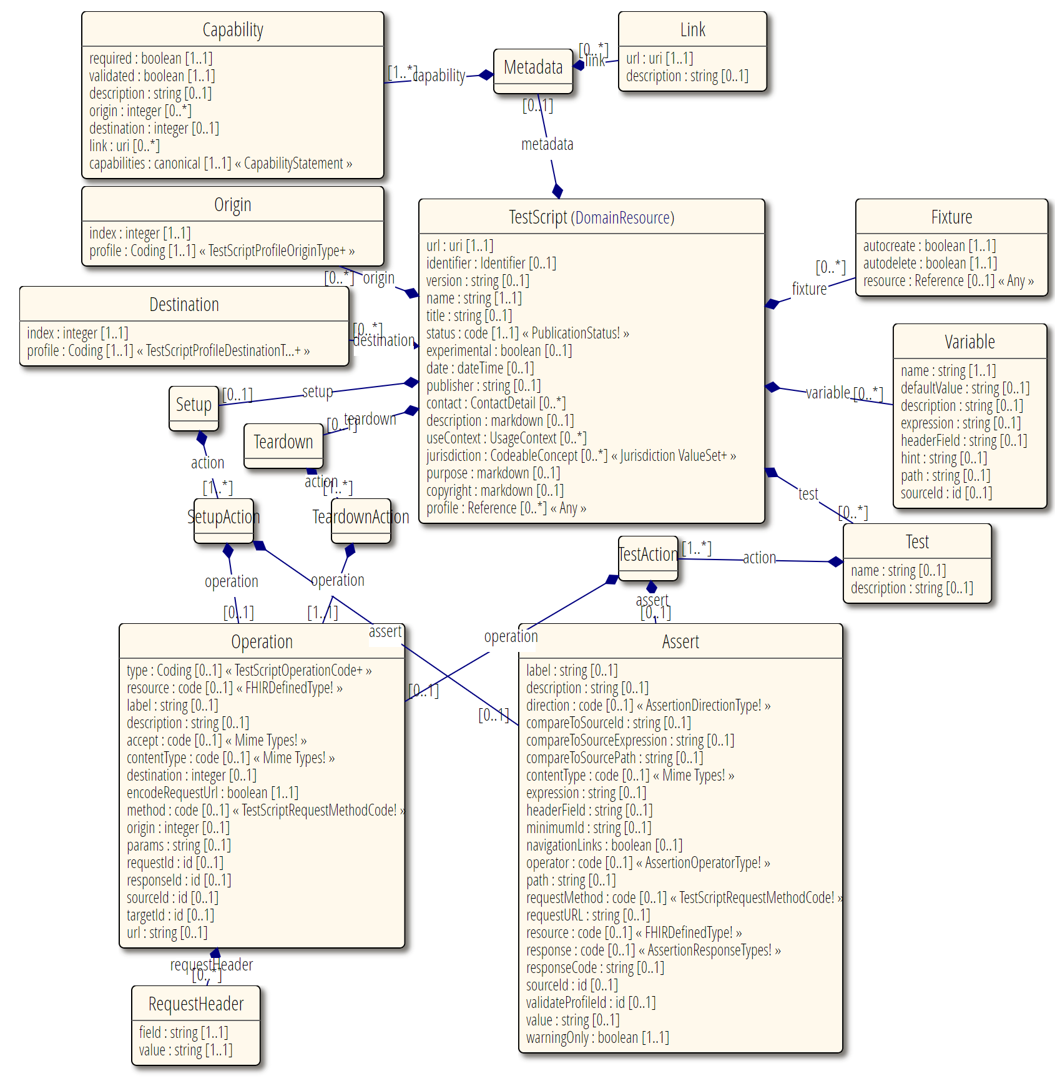
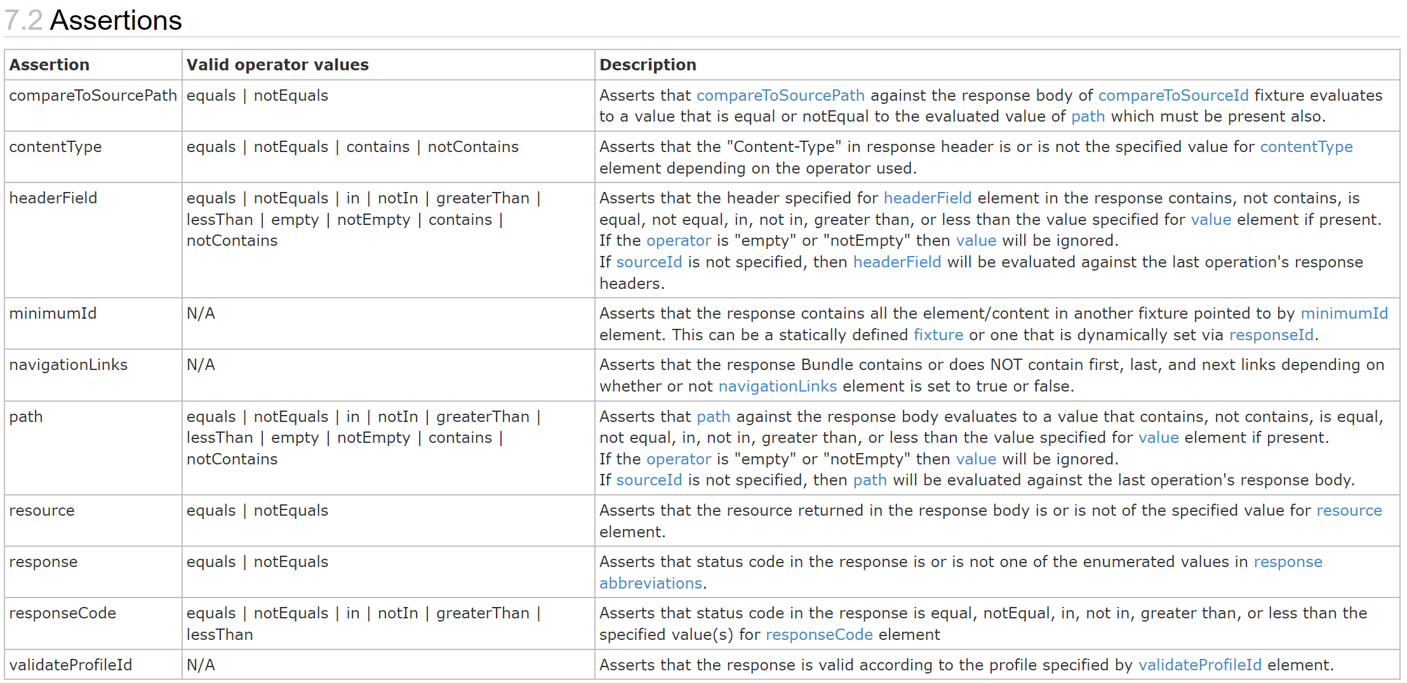
Spec-to-Test Strategy – FHIR TestScript “Friendly”
<do the analysis (see slide #36)>
<normalize with MODEL of TESTING>
https://www.hl7.org/fhir/testscript.html
https://www.hl7.org/fhir/testing.html

Slide 43
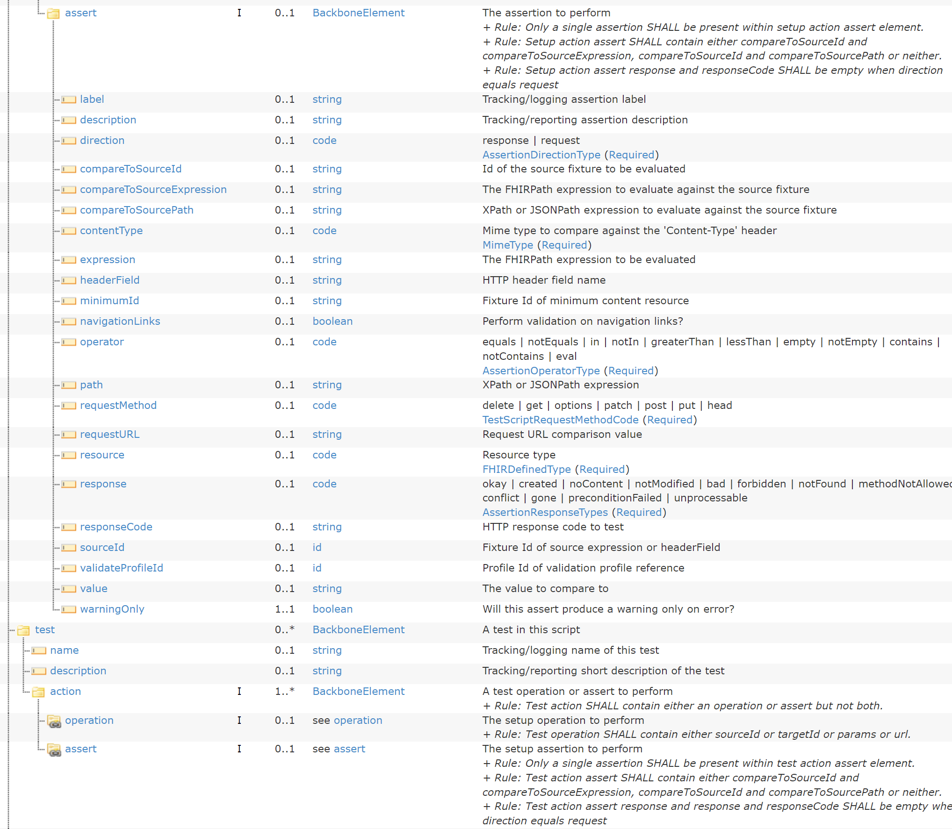
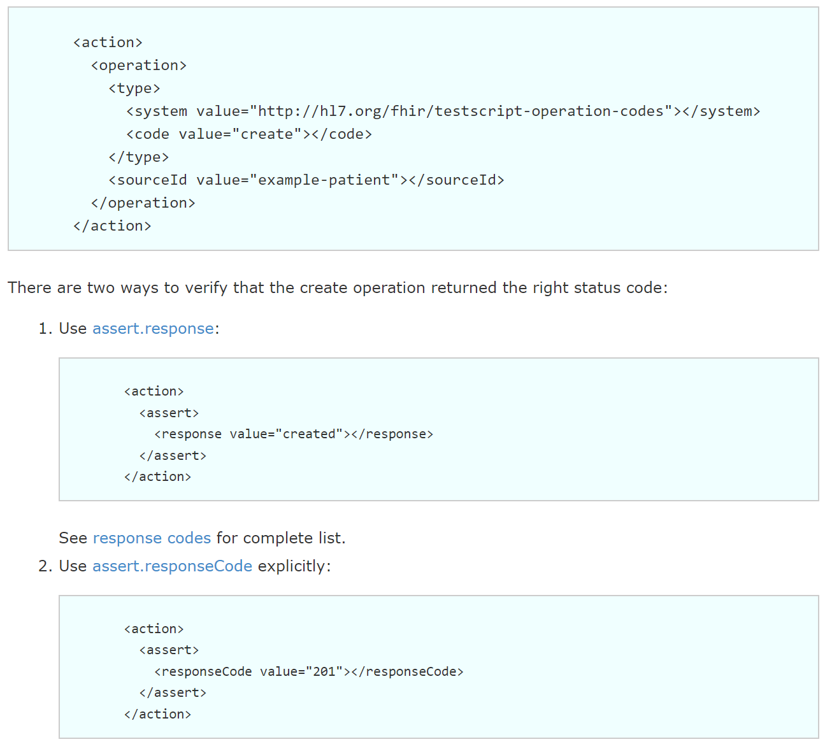
Spec-to-Test Strategy – FHIR TestScript::Assert
Specialized for FHIR testing …
How does this compare to OASIS TAML?
https://www.hl7.org/fhir/testscript.html

Slide 44
Spec-to-Test Strategy – FHIR TestScript::Assert
How does this compare to OASIS TAML?
How does this compare to Gazelle TA Tooling?

Slide 45
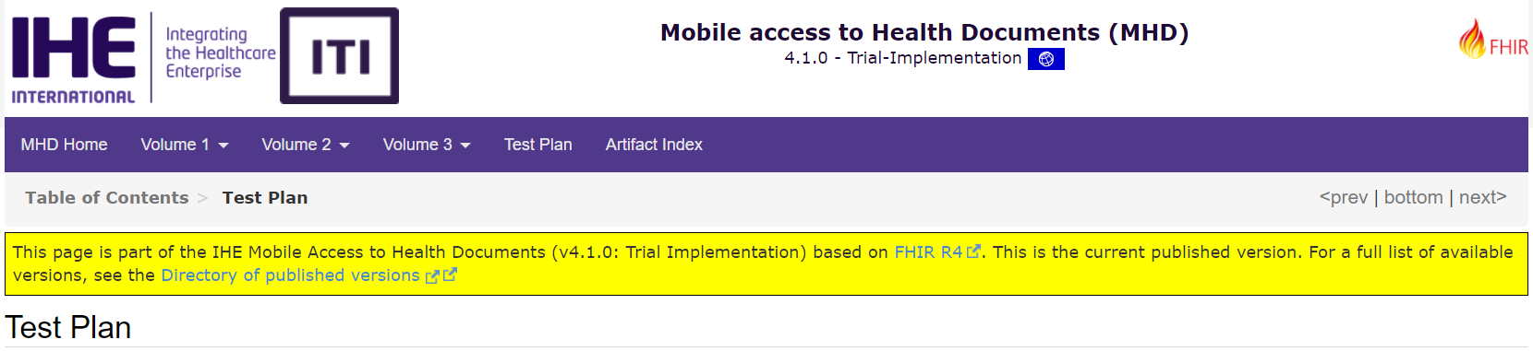
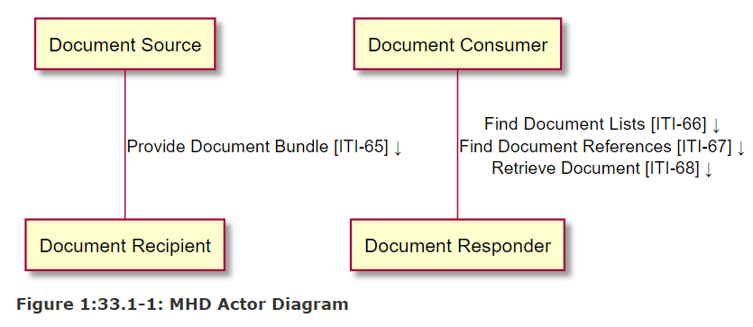
Spec-to-Test Strategy – MHD & FHIR Test Plans
MHD Test Plan
Focus: Server-side actors – Document Recipient & Responder
Tests support MHD infrastructure (incl. XDS on FHIR) options and variations
Unit Test Procedures (Conformance Testing) per MHD Actor utilize Simulators / Validators
Unit Test Tools include: NIST Asbestos (Simulator & Validator) + KEREVAL Gazelle EVS Client (V only)
Integration Test Procedures (Interoperability Testing) build on unit conformance testing (pre-CAT)
All Actors & Transactions include StructureDefinition & CapabilityStatement profile artifacts (see ITI Appx. Z)
MHD Tests are defined in the Gazelle Master Model
MHD FHIR TestScript Usage? Enter: NIST “Asbestos” Toolkit!
Source: IHE MHD Test Plan
See also Gazelle FHIR CapabilityStatement Usage

Slide 46
Spec-to-Test Strategy – MHD & FHIR TestScripts
NIST “Asbestos” Use of FHIR TestScript
NIST Asbestos Tool supports MHD testing (incl. “XDS on FHIR”)
FHIR TestScript is used for FHIR-based profile testing (actors, transactions, …)
Extensions to TestScript added to improve modularity + failure handling
Asbestos architecture should allow for SDPi (SDC + FHIR) testing
TestScript: ID, Name, Description Fixture(*), Test({Operation | Assertion})
See: Asbestos MHD Test Collections
Source: NIST Asbestos Github Project Wiki

Slide 47
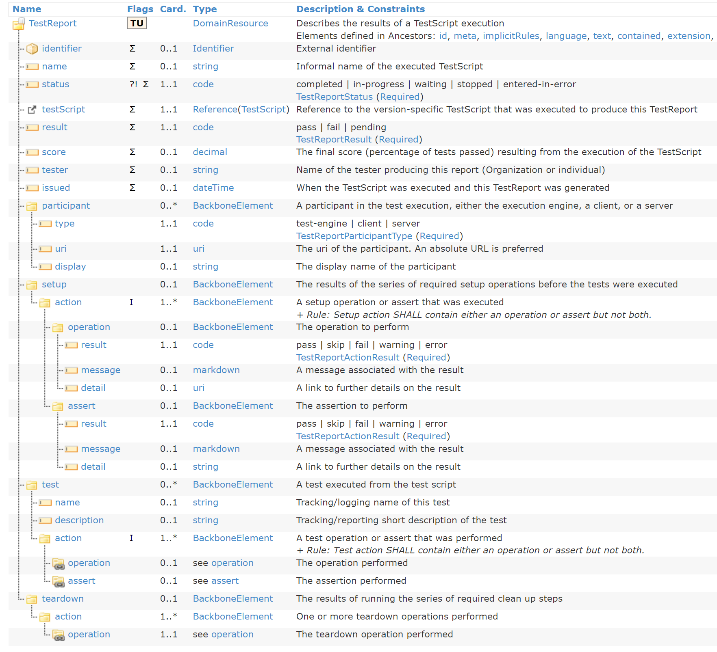
Spec-to-Test Strategy – FHIR TestReport “Friendly”
<compare to what we need for GMM/TM>
? TestScript & TestReport … independent?
MHD Use?
https://www.hl7.org/fhir/testreport.html#TestReport

Slide 48
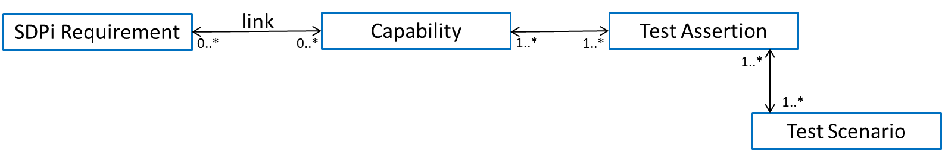
Spec-to-Test Strategy – Testable Assertions?
Where do Testable Assertions live?!
What do they look like? (format, element content)
Factor in Gazellel TA tool
Factor in FHIR TestScript / Assertion logic
Do we need to integrate a test data file?
Do we need to link assertions with more than the end “edge” requirements – given RI that lead back to the source(s)?
Do we need assertions tied to Use Cases at some level?
SysML 2.0 constructs … at least to provide the target?
Michael Faughn:
TA’s are REUSABLE across test scripts & test cases, soooooo
TA’s are independent and live on their own, sooooo
TA’s should be maintained … SEPARATELY and then integrated
NOTE: This point is lost in FHIR TestScript …
Note Asbestos via FHIR Extension tries to make Assertions reusable

Slide 49
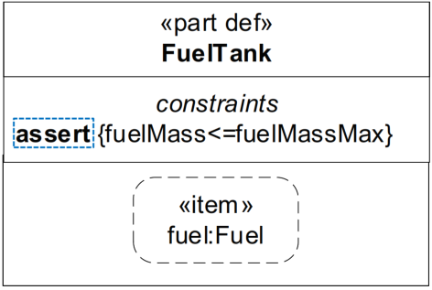
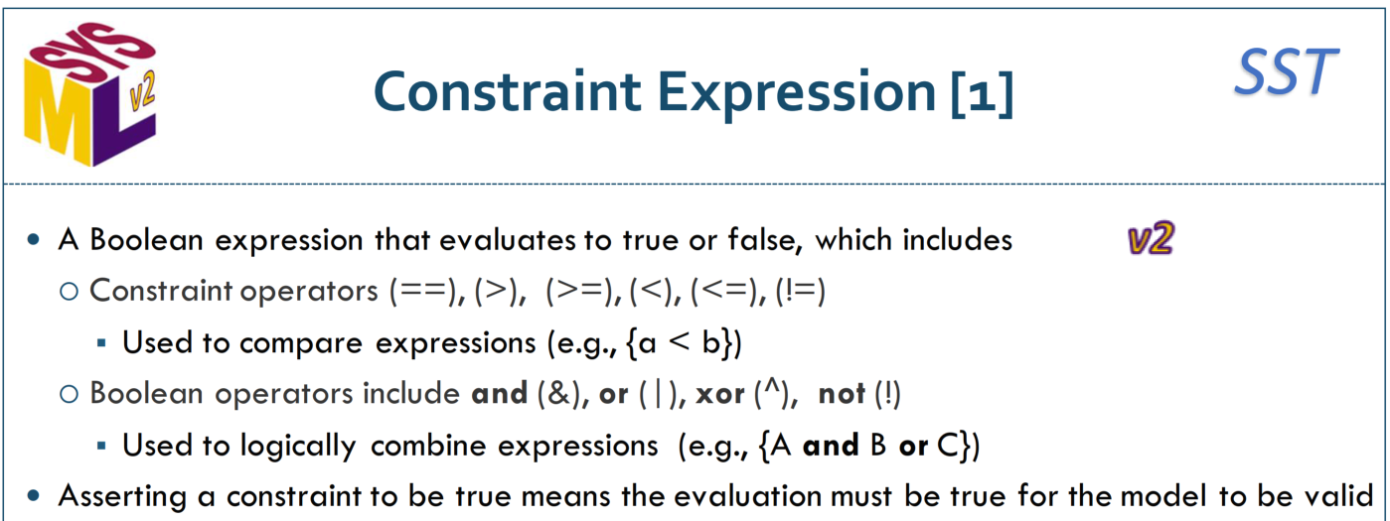
Spec-to-Test Strategy – SysML 2.0 Constructs?
“MC” – IF Ultimately accomplished with MBSE/SysML 2.0, THEN …
Are there constructs that can be used TODAY that would simplify that migration later?
How are test cases, Verification capabilities supported in SysML 2.0?
SysML 2.0 – Constraint expressions & “assert” logic

Slide 50
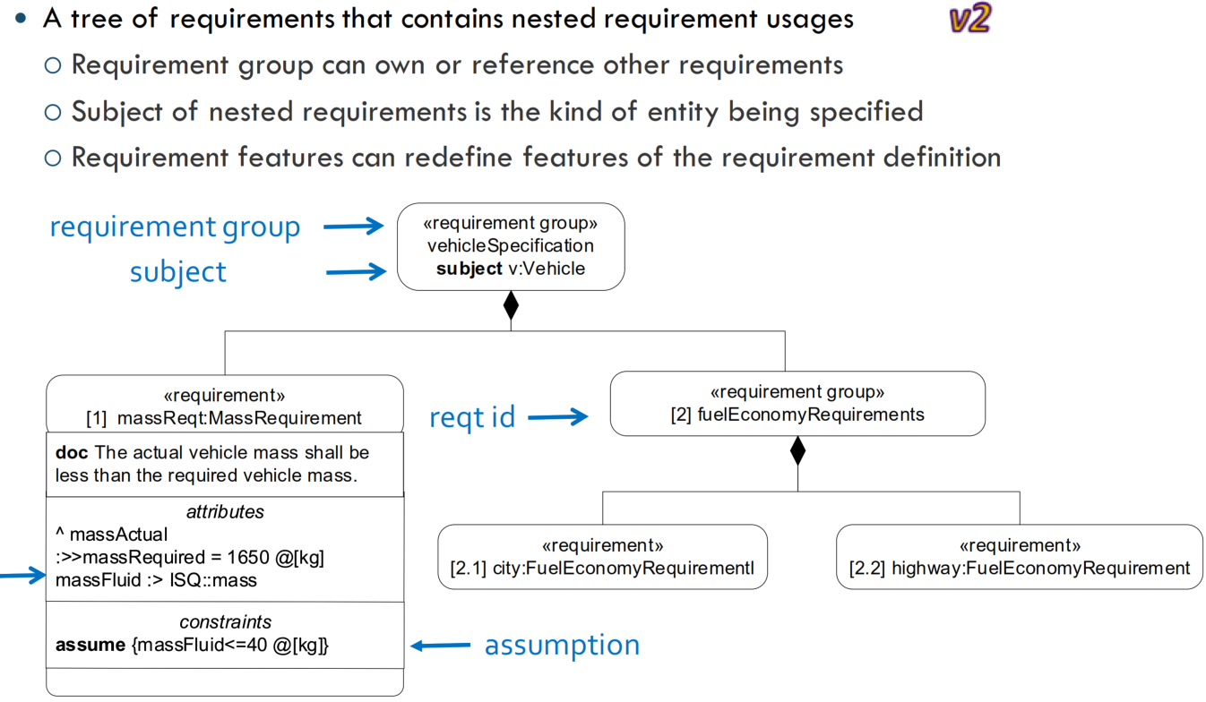

Spec-to-Test Strategy – SysML 2.0 Constructs?
SysML 2.0 – Requirements Specification w/ Constraints

Slide 51
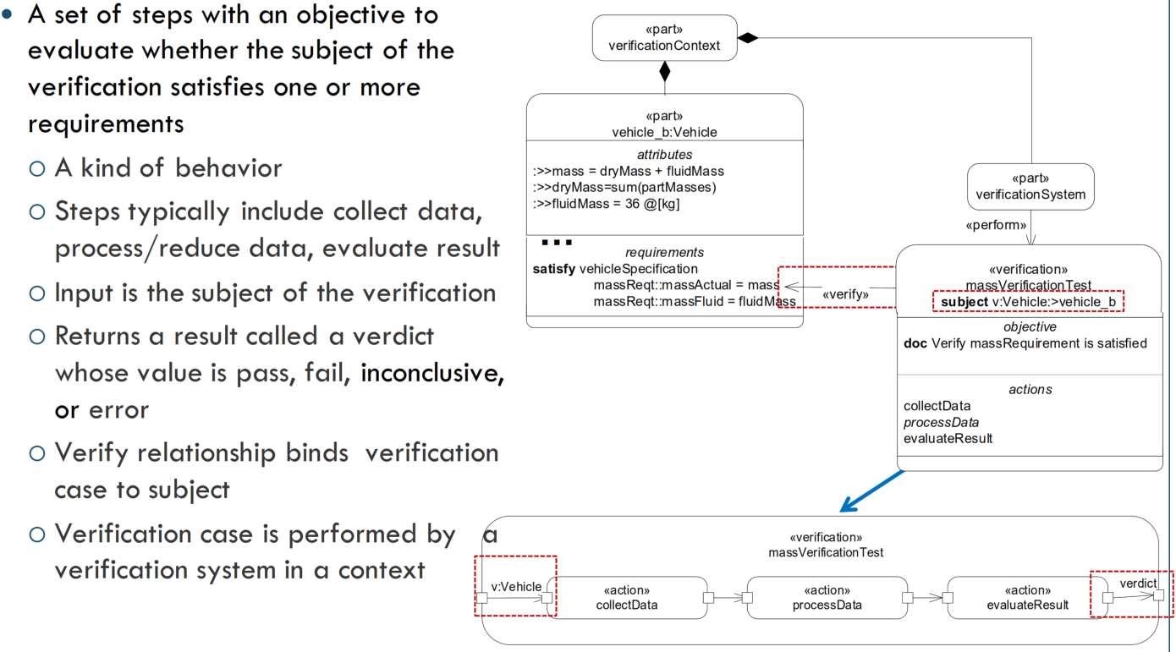
Spec-to-Test Strategy – SysML 2.0 Constructs?
SysML 2.0 – Verification Cases

Slide 52
Spec-to-Test Strategy – SysML 2.0 Constructs?
“MC” – IF ultimately accomplished with MBSE/SysML 2.0, THEN …
Are there constructs that can be used TODAY that would simplify that migration later?
How are test cases, Verification capabilities supported in SysML 2.0?
SysML 2.0 –
Constraint language could be used today for assertion predicates
Requirements hierarchy could be supported today (albeit by UML model, not automation)
Notes:
Ultimately, SysML 2.0 will fully support simulation (incl. V&V)
MBSE use of SysML 2.0 to support V&V / CA … was not included here

Slide 53
Spec-to-Test Strategy – Open Issues
Additional Spec-to-Test Strategy issues …
<What’s missing?>

Slide 54
Gemini SES+MDI – 2022 RI+MC+RR Strategy – NIST “Asbestos” Tool for IHE Testing
Given the landscape evaluation, the IHE test artifacts (tests, assertions, Gazelle), the current focus on FHIR even for infrastructure / automated test tooling (FHIR TestScript, TestReport) and the work NIST is advancing for IHE FHIR-based profile testing with MHD and “XDS on FHIR” … could this be the best approach forward?

Slide 55
Test Tool Strategy – NIST Asbestos Consideration
To Do:
Slide: Why Asbestos? (leverage FHIR, Gazelle integration, will eventually need for FHIR Gateway actors, architecture allows SDC-to-SDC … don’t reinvent the wheel!; reference implementations can plug into the tool set)
Asbestos architecture (overview / big picture)
Asbestos: MHD Testing, Gazelle Integration
Scenarios for consideration: SDC-to-SDC testing, SDC-to-DoF, …
HOW FAR CAN IT GO? Content testing as well as basic WS* protocol testing?

Slide 56
Test Tool Strategy – Why IHE SDPi for CA?
Rationale for utilizing IHE Profiling, Testing & CA vs. SDC Only
Any product implementation requires integration and conformance to many different standards and specifications
IEEE 11073 SDC standards are "foundational" but include options and must be coordinated with additional standards for product implementations
Note: PKP standards are foundational, mandatory but without SDPi profiles are unimplementable in products, especially across vendors
A community of product implementers and product users must agree on specifications that span the standards and technologies that are required for interoperable systems of products
Eliminate any unnecessary optionality provided for in the referenced standards
Minimize optionality to only what is necessary for market adoption and implementation
Agility to quickly add specifications for foundational standard corrections & extensions
SDC System Function includes shared risk between component products and their System Function Contribution
Shared risk includes a shared implementation community approach to risk management and regulatory submissions
Product Conformity Assessment (with unit testing / interoperability testing events and tooling) must be agreed and recognized throughout the broad community of interest
Leverage existing health I.T.-focused implementation communities vs. “reinventing the wheel”

Slide 57
Test Tool Strategy – Why NIST Asbestos?
Landscape Realities
As stated above, current landscape “reality” can be summarized as: FHIR FHIR FHIR!
IHE Gazelle / NIST tooling / other tooling leverages FHIR TestScript, TestReport, … today
Non-device verification & CAT & product CA are increasingly using FHIR-based tooling infrastructure
NIST Asbestos was intentionally architected to support multiple protocols and “gateway” functions
NIST Asbestos already supports FHIR extensions to enable needed capabilities (e.g., modularity)
Asbestos Value Proposition
Do not reinvent the wheel: SDC tooling has to be built anyway – Asbestos reduces the work load
Artifact authoring & management (test plans / scripts, assertions, tracing) exists separately and can be leveraged by vendor tool chains
Testing that includes not only SDC-to-SDC but also SDC-to-FHIR & V2 will be a near future need
An SDC/SDPi “Reference Implementation” built for NIST Tooling? … no brainer!

Slide 58
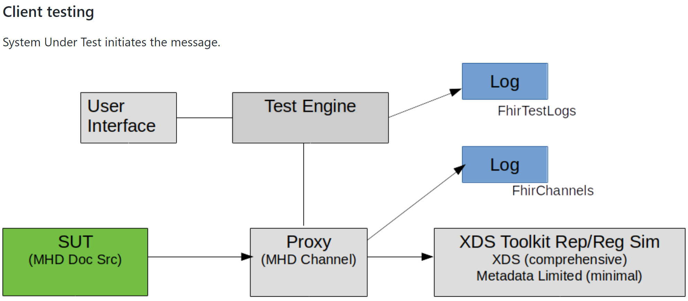
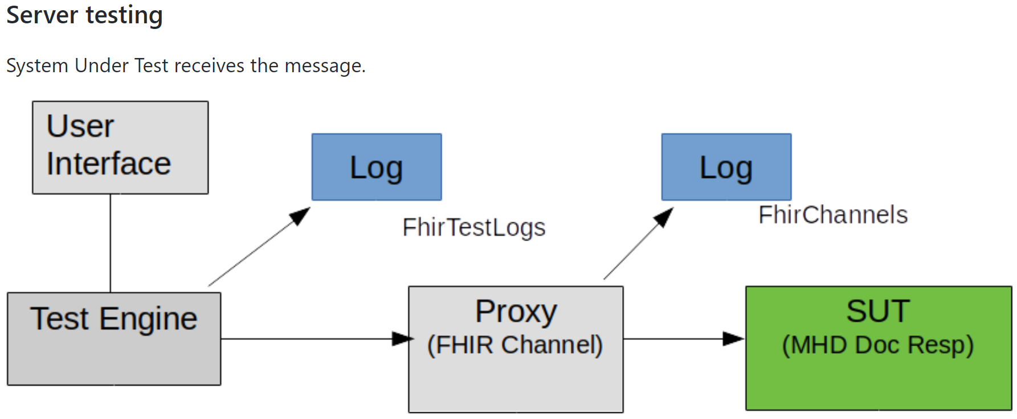
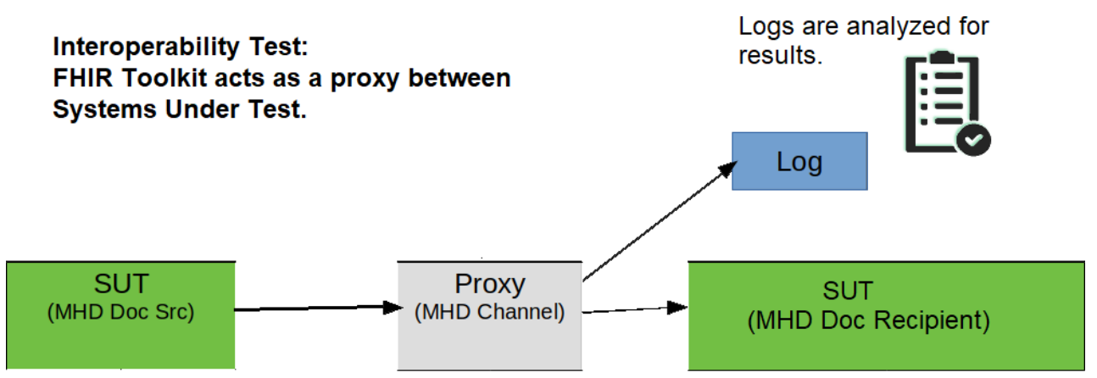
Test Tool Strategy –NIST Asbestos Architecture
XDS Simulator

Slide 59
Test Tool Strategy –NIST Asbestos Architecture
Test Engine
Executes Tests (TestScript?) & Evaluates results (using FHIRPath assertions); … < facility for non-TestScript definition / execution? Not today … may / may not be possible – esp. given HAPI FHIR engine under >
Test Log
(…)
Captures Test Instance Execution (TestReport?); …
User
Interface
Provides test configuration & control; … < configuration automatable? EVS Client? >
Proxy
(<…> Channel)
Provides end points to capture all message exchanged between actors; Channel = Protocol + Translation) <unidirectional>; transport-HTTP level / packet “content” agnostic < TLS endpoints supported>
Channel Log
(…)
Log of messages exchanged between actors; … < binary support? Format? UTF-8 today>
SUT
(Actors: <…>)
System Under Test ; … < Single AIPO? >
Simulator
(Actor(s): <…>)
Actor / SUT Simulator; Note color – may / may not be part of the tool kit < Ref. Implementations? >

Slide 60
Test Tool Strategy –NIST Asbestos for FHIR Testing
FHIR Toolkit (Asbestos)
Offers conformance and interoperability testing environment
Currently supports the FHIR based IHE MHD profile
General purpose HTTP proxy captures messages for validation purposes
Updates required to support non-FHIR messages
Uses HAPI FHIR for encoding and decoding of FHIR resources, and to evaluate FHIRPath expressions
JSON-based configurable test specification references
Greatly improves user experience with troubleshooting conformance and interoperability testing
Uses FHIR standard based TestScript with Asbestos Extensions
Reusable test components
Possible to create new TestScript extensions
FHIRPath expression only targets FHIR Resources and static expressions
Non-FHIR messages can be converted to FHIR resources through the channel transformation interface API
May require some validation to be setup inside the channel specific code
Has a channel event inspector
Supports TLS
Self-contained zip file contains Asbestos, XDS Toolkit, and HAPI FHIR JPA server
https://github.com/usnistgov/asbestos/releases/tag/v4.0.0

Slide 61
Test Tool Strategy –NIST Asbestos for SDC/SDPi
Test Scenario: SDPi-23 Announce Network Presence
User
Interface
Test Engine
Test Log
(SDPi Test)
Note: These test steps are focused on Interoperability Testing vs. Unit Testing; This scenario is intended for Unit Testing
Proxy
(SDC Channel)
Channel Log
(SDC Messages)
SDPi-23
<target recipient(s) needed here? No Peer test S-CONSUMER Simulator>
Not needed:
SUT
(Actors: S-PROVIDER)
Simulator
(Actor(s): <…>)
See test sequences @ https://confluence.hl7.org/pages/viewpage.action?pageId=113676845#ReferenceProvider/ConsumerSpecification-Teststepstobeconducted

Slide 62
Test Tool Strategy –NIST Asbestos for SDC/SDPi
Test Scenario: SDPi-24 Discover Network Topology (Part of Test Step #1)
User
Interface
Test Engine
Test Log
(SDPi Test)
Unit
Test
SDPi-24
Proxy
(SDC Channel)
Channel Log
(…)
SUT
(Actor: S-CONSUMER)
Simulator
(Actor: S-PROVIDER)
SDPi-24
Proxy
(SDC Channel)
Channel Log
(…)
<two channels needed for outgoing / incoming messages>
Interoperability
Test
(with > 2 actors)
SUT
(Actor: S-CONSUMER)
SUT
(Actors: S-PROVIDER)
Simulator
(Actor: S-PROVIDER)
See test sequences @ https://confluence.hl7.org/pages/viewpage.action?pageId=113676845#ReferenceProvider/ConsumerSpecification-Teststepstobeconducted

Slide 63
Test Tool Strategy –NIST Asbestos for SDC/SDPi+FHIR
Test Scenario: SDPi-29 Publish BICEPS Update Reports
User
Interface
Test Engine
Test Log
(SDPi Test)
SDPi-29
Proxy
(<…> Channel)
Channel Log
(…)
SUT
(Actors: S-PROVIDER)
SUT
(Actor: S-FHIR Gateway)
(PoCD DOF “DEC” Transaction )
Simulator
(FHIR Application)

Slide 64
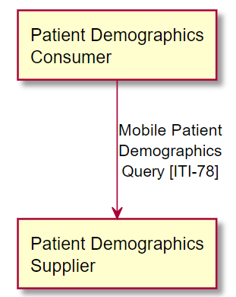
Test Tool Strategy –NIST Asbestos for SDC/SDPi+FHIR
Test Scenario: SDPi-xyz Retrieve Patient Demographics Information (PDQm)
User
Interface
Test Engine
Test Log
(SDPi Test)
SDPi-”RPD”
Proxy
(<…> Channel)
Channel Log
(…)
SDC
FHIR
SUT
(Actors: S-CONSUMER)
ITI-78
ITI-78
SDC
FHIR
SUT
(Actor: S-FHIR Gateway)
Simulator
(IHE FHIR PDQm:PDS)
Source: https://profiles.ihe.net/ITI/PDQm/index.html

Slide 65
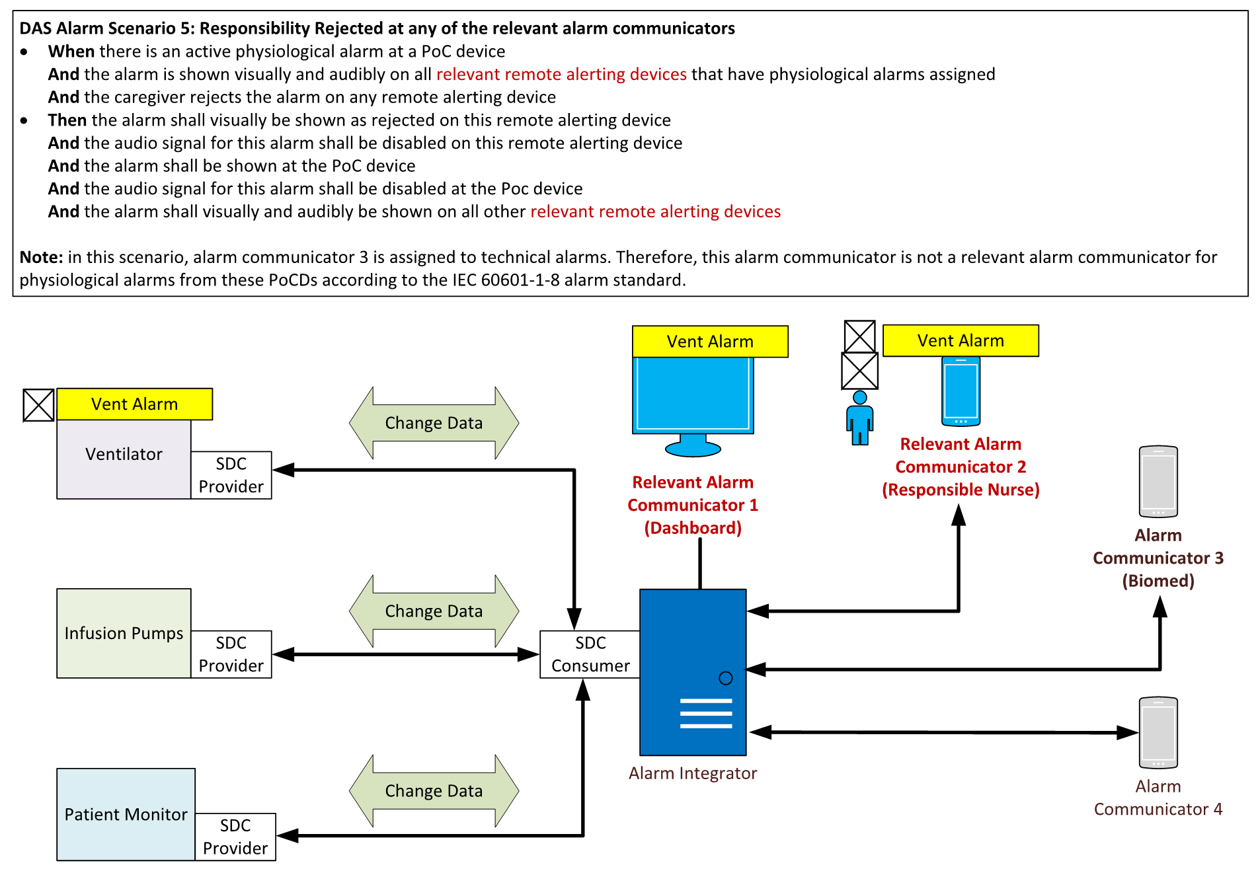
Test Tool Strategy –NIST Asbestos for HIMSS’23++
What test tool support do we need for HIMSS’23 Showcase systems … and beyond?
SOMDS Vent
SOMDS Pump
SOMDS DAS AI System
SOMDS Monitor
SOMDS SAS
“Silent ICU” HIMSS’23 Demo
See detailed scenarios posted at Gemini Topic of Interest DAS + Smart Alerting Challenges
SAS = Smart Alert System
DAS AI = Distributed Alarm System / Alarm Integrator

Slide 66
Test Tool Strategy –NIST Asbestos for HIMSS’23++
SOMDS Proxy Tool
Secure End Points (TLS … OAuth)
Multi-Protocol Support (SDC … FHIR, V2)
“Translation” (SDC … FHIR, V2 + profiles)
Peer-to-Peer / No Peer Testing
“Broadcast” End Point Support
Multi-transport Support (SOAP … gRPC/proto)
Browsable Message Log
Unit & Interoperability Testing Ready
Test Engine Integration (e.g., for validation)
Real-time Ready (proxy shouldn’t introduce impactful performance delays)
SOMDS Vent
SOMDS Pump
SOMDS DAS AI System
SOMDS Monitor
SOMDS SAS
“Silent ICU” HIMSS’23 Demo
SOMDS Reference Actor Implementations
Simulators for actors (SDPi-P / -R / -A / -xC)
Support no peer & peer-to-peer testing
…

Slide 67
Test Tool Strategy –NIST Asbestos for HIMSS’23++
SDC/SDPi+FHIR Test Engine
<UI – Test configuration / review>
<Proxy interface>
<TestScript – execution>
<TestReport log>
…
SOMDS Vent
SOMDS Pump
SOMDS DAS AI System
SOMDS Monitor
SOMDS SAS
“Silent ICU” HIMSS’23 Demo
<authoring of TA & Script etc.>
…

Slide 68
Test Tool Strategy –NIST Asbestos Assumptions
Consider the following assumptions around the use of Asbestos …
<alternate transports OK … gRPC / protobuf>
<security can be re-used>
No particular order … WIP!
<V2 actors can be supported>
<multi-way 3+ actor interactions can be supported>
<timing constraints can be managed – with Proxy in the middle>
< TestScript & TestReport + Test Assertions can be leveraged to capture the needed semantics >
< Leveraging FHIR-based constructs is not a slippery slope from which there is no return! >
< Can be / has been integrated as a Gazelle EVS Client … yes? >
<WS* already supported with XDS … MDPWS should be relatively simple>
< Supports Gazelle Test Collection / Test Definition / Test Script model (see slide #21) >
< Meta-test engine model can be (has been?) defined and then mapped for Asbestos + Gazelle use >
< Common technologies like Java, Python … docker? … can be used >

Slide 69
Test Tool Strategy –NIST Asbestos for MHD Testing
To Add:
MHD TestPlan content
Use of TestScript (examples from Asbestos repo)
Use of TestReport
FHIR Assert examples
Gazelle Integration

Slide 70
Test Tool Strategy –NIST Asbestos for SDPi Testing
Scenarios to add
No Peer SDC Client & Server (Consumer / Provider) Testing
Peer-to-peer SDC CONSUMER / PROVIDER Testing
Multi-way SDC “ensemble” testing
SDPi FHIR Gateway actor testing (to FHIR, from FHIR)
Extensions to add?
Simulator?
Issues: Will real-time test execution be an issue? (for D2D interactions)

Slide 71
Test Tool Strategy –NIST XDS Toolkit Constructs?
Testing Methodology
https://github.com/usnistgov/iheos-toolkit2/wiki/Testing-Methodology
Writing Conformance Tests
https://github.com/usnistgov/iheos-toolkit2/wiki/Writing-Conformance-Tests
Testplan Design Patterns
https://github.com/usnistgov/iheos-toolkit2/wiki/Testplan-Design-Patterns
Test Assertion Plugins
https://github.com/usnistgov/iheos-toolkit2/wiki/Test-Assertion-Plugins
Tests are located in the 'tests' subdirectory of this parent 'testkit' directory
https://github.com/usnistgov/iheos-toolkit2/tree/master/xdstools2/src/main/webapp/toolkitx/testkit
If you would to see Asbestos FHIR TestScript artifacts, please check the individual test collection subdirectories in
https://github.com/usnistgov/asbestos/tree/master/asbestos-war/src/main/webapp/data/TestCollections
Here’s a quick comparison between XDS Toolkit and FHIR Toolkit (Asbestos):
XDS Toolkit
Offers conformance and interoperability testing environment
Currently supports the IHE XDS/XDS-I profile
XDS-I simulators were developed Steve Moore (WUSTL)
XML based test plan structure
Stack-based validation API
External validation plugin API
Existing simulators are specific to XDS and XDS-I environment
New simulator types can be developed
Has a proxy simulator but not widely used
Supports Mutual TLS
Has a interaction sequence diagram generator
Has a transaction Inspector
Downloadable WAR file can easily be deployed to a web server container such as Tomcat
https://github.com/usnistgov/iheos-toolkit2/releases/tag/v7.7.2

Slide 72
Test Tool Strategy –NIST XDS Toolkit Constructs?

Slide 73
Test Tool Strategy –NIST …

Slide 74
Gemini SES+MDI – 2022 RI+MC+RR Strategy – IHE DE PAT Testing – May 2022
Starting point for the 2022 testing strategy includes what has been progressed as part of the IHE Germany Plugathon (PAT) testing events, and … how much of this approach and tooling can be leveraged going forward?

Slide 75
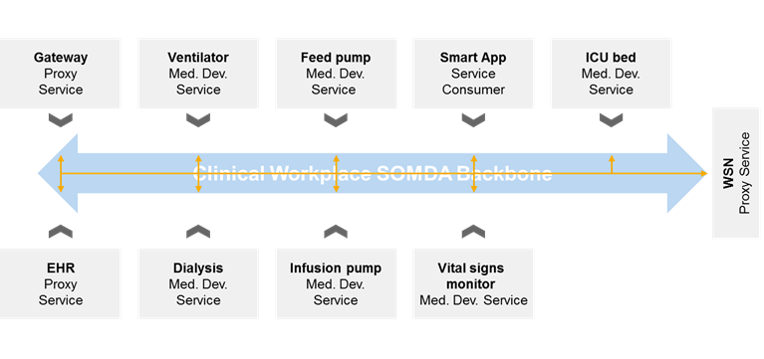


Test Tool Strategy – IHE DE PAT ‘22 Testing
Service
Provider Consumer
Service
Provider
Service
Provider
Service
Consumer
Communication Backbone
Consumer
Provider Consumer
Provider Consumer
Provider
Compares actual exchanges (from PROVIDER SUT) with Reference MDIB
Test app (consumer)
Device under test (provider)
Test Result

Provider
Reference Provider MDIB
TLS Certificates
App at https://github.com/IHE/sdpi-fhir/tree/master/Tooling/sdc11073
MDIB & Certificates @ https://confluence.hl7.org/x/LZLGBg

Slide 76
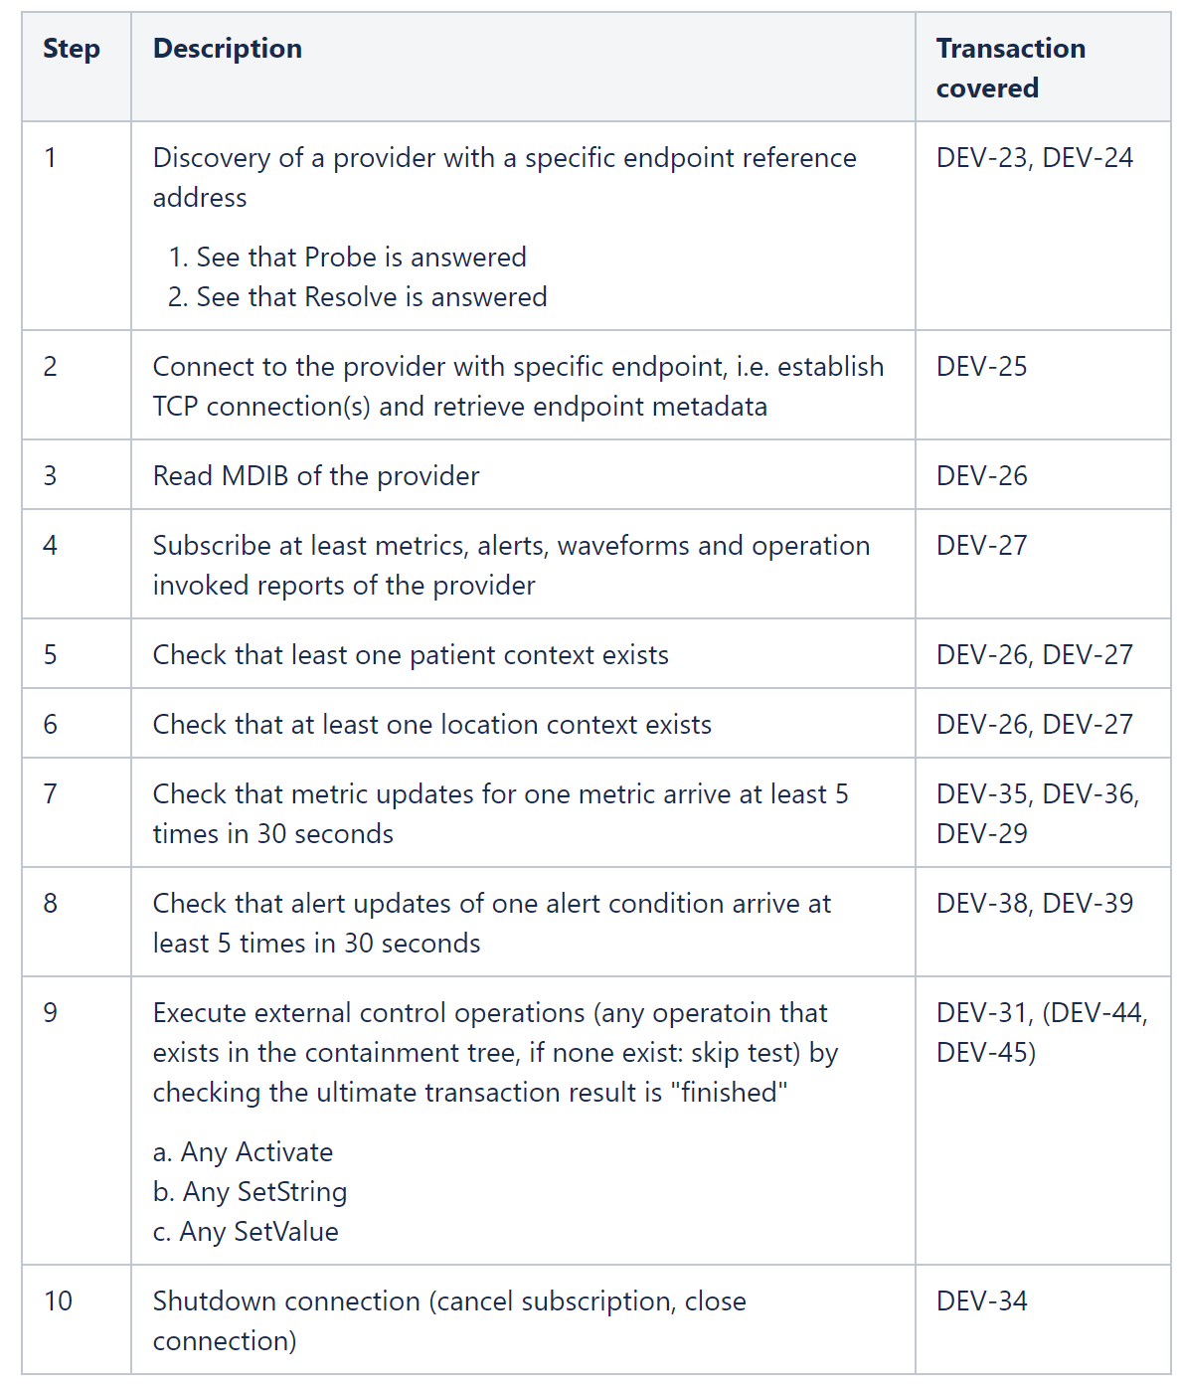
Test Tool Strategy – IHE DE PAT #7 ‘22 Testing
See PAT #7 Test Matrix for Example Results
What does a PAT testing event look like?
Configure & connect systems per network settings (e.g., #7)
SDC PROVIDER systems tested w/ Reference Consumer App
(akin to Pre-CAT … or Pre-PAT testing)
SDC PROVIDER & CONSUMER systems work through the test sequences for interoperability testing
What current PAT testing does not include:
Unit Testing (automation)
Consumer SUT Testing (unit)
Proxy (with security)
Test “Engine” w/ scripts & reports & configuration …
(see sdcTest in github sdpi-fhir github repo)
Source: https://confluence.hl7.org/x/LZLGBg

Slide 77
Test Tool Strategy – Testing for HIMSS’23 & Beyond
HIMSS’23 Interoperability Showcase Demo: Silent ICU (incl. DAS / DIS Support)
SOMDS Vent
SOMDS V2 Gateway
(ACM AS /
DEC DOR)
PCD-4 / -5
<SDC>
ACM Alert Manager
SOMDS Pump
SOMDS DAS AI System
EHR
PCD-1
SOMDS FHIR Gateway
<SDC>
SOMDS Monitor
FHIR Msgs
FHIR Server
FHIR Search / PubSub
Analytics / CDS / DIS
SOMDS SAS
ITI-78
PDQm (supplier)
“Silent ICU” HIMSS’23 Demo
SAS = Smart Alert System
DAS AI = Distributed Alarm System / Alarm Integrator
Notes:
PDQm & EHR & ACM included for illustrative purposes; may not be in ‘23 demo
SOMDS Gateway actors are specialized – not shown here - for each of the (4) profiles
SOMDS systems can integrate both Service Provider & Consumer actors
Gateways can be bi-directional (both Service Provider & Consumer actors)
<SDC>
<FHIR>
<V2>
See detailed scenarios posted at Gemini Topic of Interest DAS + Smart Alerting Challenges

Slide 78
Gemini SES+MDI – 2022 RI+MC+RR Strategy – Possibilities but not Probabilities but .. Opportunities?!
“Basic Support” focuses on what we can do NOW with what we have in hand NOW, but in parallel there are activities that could provide additional opportunities for achieving RI+MC+RR support … beyond basic!

Slide 79
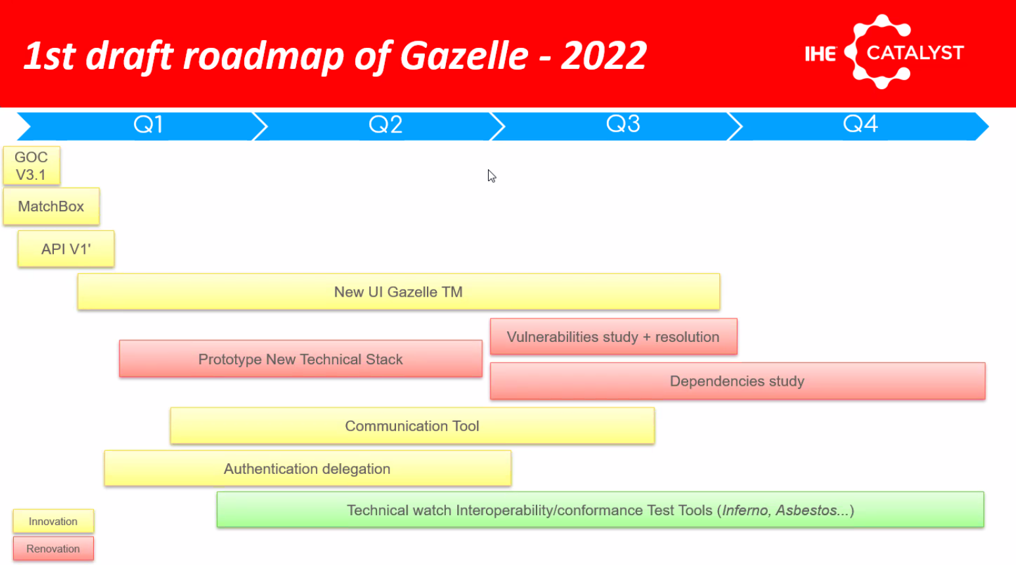
Positive Risk Strategies – ‘22 Gazelle Evolution
Gazelle 2022 Draft Roadmap includes:
EVS API (v1)
New Gazelle Test Management (TM) User Interface
Probability: Confidence this will actually happen?
Positive Risk?
If it does in Q1, we may be able to leverage the EVS API for SDC test tool integration
Consider (dated version):
https://app.swaggerhub.com/apis/gazelletestbed/gazelle-evs_client_api/3.0#/

Slide 80
Positive Risk Strategies – SysML 2.0 Surfaces!
MBSE / SysML 2.0 recognized as opportunities to
Realize full potential of migrating to a “model centric” paradigm
Move from Gherkin and ReqIF, which are functionally obviated
Probability: Not clear given the lack of tool vendor “betas”?
Positive Risk?
If we do start to use SysML 2.0 constructs, then when tooling surfaces … bang!

Slide 81
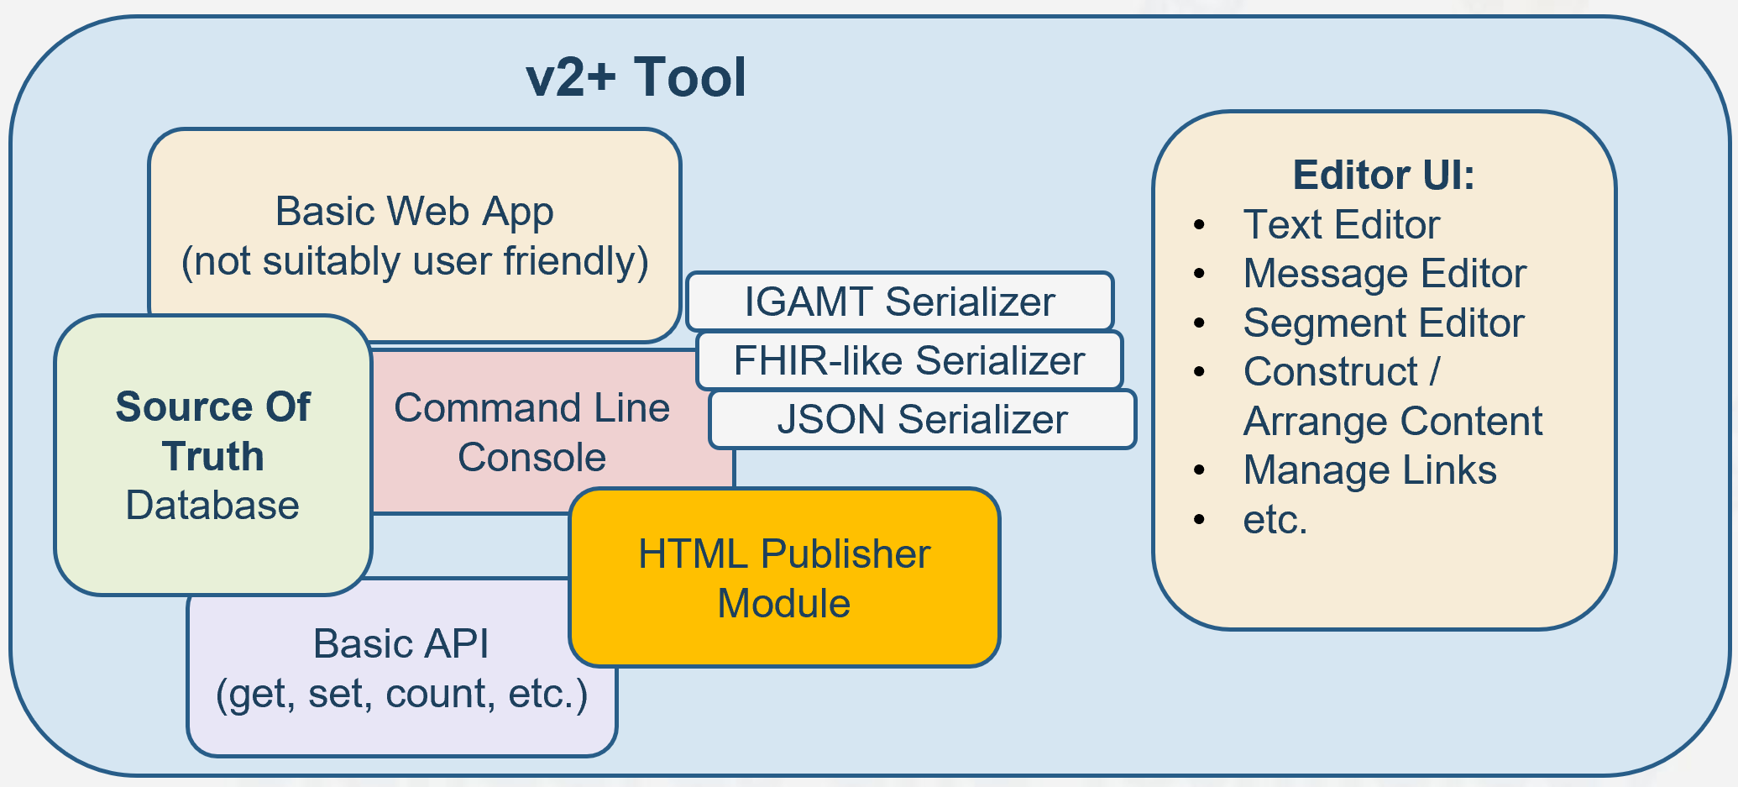
Positive Risk Strategies – Alternate Standard Editor
Consider:
Note #1
Note #2
Source: Michael Faughn 2022 January WGM Update
Probability: Definite maybe – but when? In 2022?
Positive Risk?
Though not in time for SDPi 1.0, migration to this would be excellent for 2.0++!

Slide 82
Positive Risk Strategies – Productive Capacity Up!
Consider 2022 Gemini Roadmap goals …
To set up a new (funded) program home
To publish, test, educate … market! … SDC/SDPi+FHIR …
To expand the community of interest / adopters / implementers
Probability: Outlook is good that increased momentum will also result in increased productive capacity (incl. new resources) … but MedTech does move sloooowly!
Positive Risk?
If successful, then the Gemini SES+MDI roadmap can be accelerated & expanded

Slide 83
Positive Risk Strategies – Other Possibilities …
Brainstorming Discussion!

Slide 84
Gemini SES+MDI – 2022 RI+MC+RR Strategy – SDPi 1.0 – Roadmap Considerations
Given the preceding approaches for advancing support now for RI+MC+RR, how will that be reflected in the 2022 SDPi 1.0 Roadmap?

Slide 85
SDPi 1.0 & RI+MC – “Basic” Support
What does SDPi 1.0 “Basic” Support look like?
SDPi 1.0 Specification –
Word-based – > 200 page supplement “skeleton” already crafted
Publish as PDF (traditional) – optionally HTML via NIST V2plus Tooling (adapted)
2022 Capabilities identified in the roadmap are detailed in the TF supplement
Requirements Interoperability –
RI UML Model linked to Word constructs (Styles / Bookmarks / Links)
Requirements sources modeled: Use Cases + Ref’d Standards + SES/RM + Tech Specific
Requirements flow established: TF-1 Appendix B & C to TF-1, TF-2 & TF-3 elements
Model Centric –
Basic UML Model for RI + Testing Elements … perhaps incl. modeled IHE TF elements
NIST tooling (for V2plus) leveraged to create initial “single source of truth” database

Slide 86
SDPi 1.0 & RI+MC – “Basic” Support
What does SDPi 1.0 “Basic” Support look like?
Regulatory Ready / CA & Tooling –
Test plans / cases incl. content as for previous profiles … but maintained external to test tooling
IHE PAT events leveraged to continue test tooling & test cases / scripts development
Manually integrate into Gazelle … as for previous profiles
Test plan / case information and linkages integrated into SST Database for basic RI –
traceability & coverage from test cases to requirement sources

Slide 87
SDPi 1.0 & RI+MC+RR – Roadmap Considerations
2022 Spec-to-Test Strategy Roadmap
<reference the items on slide #7 & #8>
<break down each for what needs to be developed per the detail sections>

Slide 88
IHE-HL7 Gemini SES+MDI – From Use Cases to Test Reports – 2022 RI+MC+RR Strategy
FHIR is a trademark of Health Level 7, International.
SDC is a registered trademark of OR.NET

Slide 89
Additional Materials

Slide 90
Orientation Tour: IHE TF & SDPi Profiles
Service-oriented Device Point-of-care Interoperability (SDPi)
Four profile specifications:
SDPi-P for Plug-and-Trust Interoperability
SDPi-R for Reporting Medical Information
SDPi-A for Alerting
SDPi-xC for External Controlling
Three IHE DEV TF Volumes:
TF-1 Profiles / use cases / actors / …
TF-2 Transactions / MDPWS messaging
TF-3 BICEPS content modules / device specializations
See draft SDPi Supplement Word Document for additional content detail & outline (https://github.com/IHE/sdpi-fhir/tree/master/SDPi%20%20Supplement/SDPi%20Rev%201.0)

Slide 91
Orientation Tour: From Volume 1 to 2 to 3
SDPi TF Supplement Vol.1 Integration Profiles
SDPi-P Profile
Profile Actors & Transactions & Content Modules
Profile Actor Options
Profile Overview (Concepts & Use Cases)
SES Considerations
SDPi-Reporting Profile …
SDPi-Alerting Profile …
SDPi-xControl Profile …
Appendix A: Requirements Management for Plug-n-Trust Interoperability
Appendix B: ISO/IEEE 11073 SDC Requirements Coverage
<including ISO/IEEE 11073 SDC ICS tables>
Appendix C: Device Point-of-care Interoperability Use Cases
<including Gherkin detail & links to Compendium etc.>
SDPi TF Supplement Vol.2 Transactions
DEV-23 Announce Network Presence
Scope
Actor Roles & Referenced Standards
Messages (at BICEPS level w/ links to Appendix A)
Protocol Requirements
SES Considerations
DEV-24 Discover Network Participants
…
DEV-44 Invoke Medical Control Services
Appendix A: ISO/IEEE 11073 SDC / MDPWS Message Specifications (Normative)
SDC/BICEPS to SDC/MDPWS Message Specifications
Messages for BICEPS Discovery Model
<specific MDPWS message links>
<example exchanges & library calls>
MDPWS Message Detail in Appendix
M:N Profiles & Transactions
See SDPi Supplement (1.0) document in the IHE sdpi-fhir Github repository for full details.

Slide 92
Orientation Tour: From Volume 1 to 2 to 3
SDPi TF Supplement Vol.1 Integration Profiles
SDPi-P Profile
Profile Actors & Transactions & Content Modules
Profile Actor Options
Profile Overview (Concepts & Use Cases)
SES Considerations
SDPi-Reporting Profile …
SDPi TF Supplement Vol.3 Content Modules
DEV Semantic Content Modules
General Device Content Considerations
…
SDC / BICEPS Semantic Content
DEV Specialization Content Modules
Device: Infusion Pump
…
SDC / BICEPS Content Module
Device: Ventilator …
Device: Physiologic Monitor …
Devices: Surgery … (new)
Devices: Anesthesia … (new)
Devices: Dialysis … (new)
SDPi TF Supplement Vol.2 Transactions
DEV-23 Announce Network Presence
Scope
Actor Roles & Referenced Standards
Messages (at BICEPS level w/ links to Appendix A)
Protocol Requirements
SES Considerations
DEV-24 Discover Network Participants
…
Bindings – General & Specific
See SDPi Supplement (1.0) document in the IHE sdpi-fhir Github repository for full details.

Slide 93
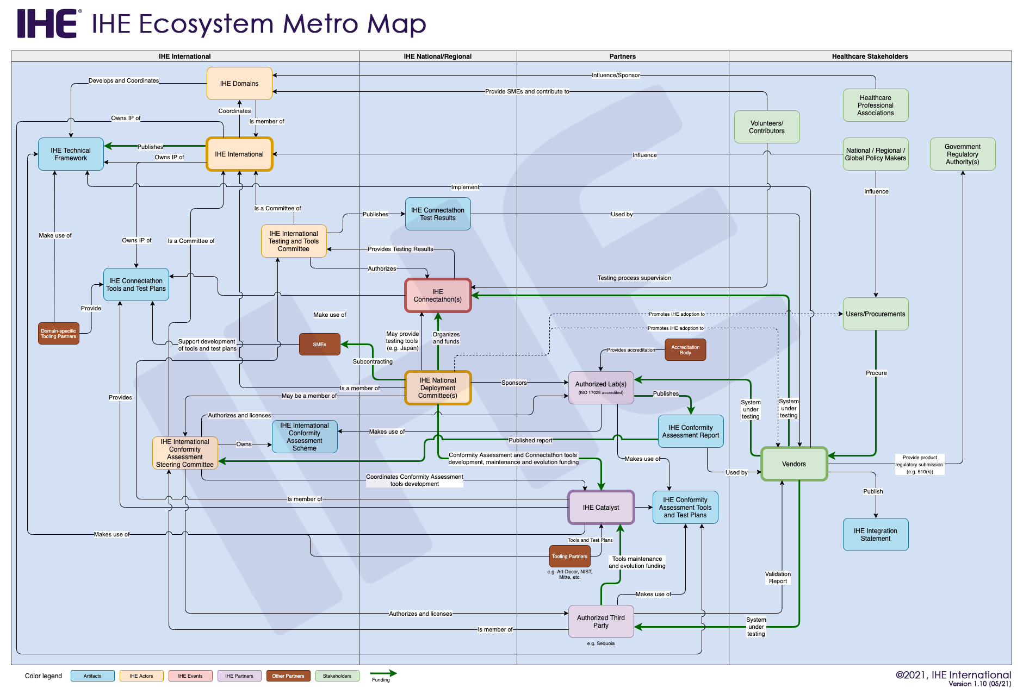
IHE Catalyst (formerly IHE EU/IHE Services)
Factoring in the IHE Testing Continuum & Ecosystem ….
2021.09 Gemini Update to IEEE-HL7 WGM
IHE Catalyst is central to all IHE based CA & Testing
Gemini program “home” considered for Catalyst or HL7
Study project (funded) being advanced with IHE Catalyst

Slide 94
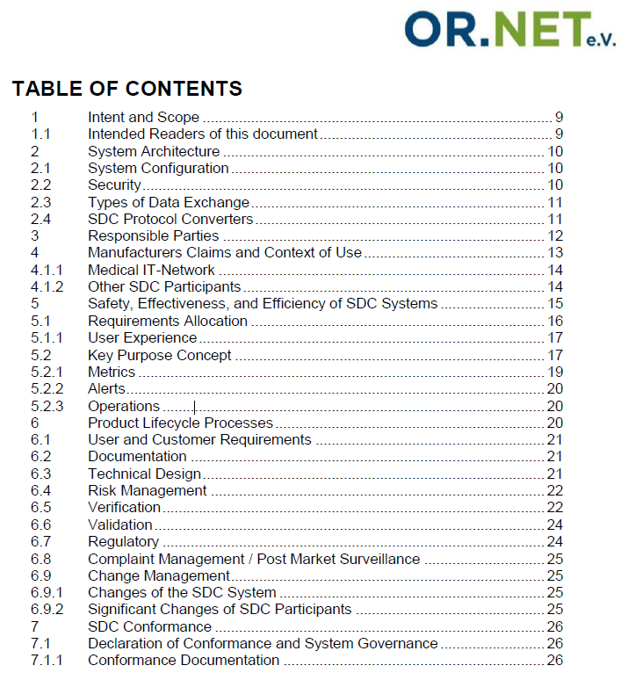
SDC Conformance Principles
OR.NET white paper lays foundation for traceability from PKPs to Conformity Assessment (CA) and certified safe-effective-secure (SES) interoperable medical device system components.
IHE SDPi Supplement TF-1 annex includes a summary of Conformance Principles
Download @
https://ornet.org/en/download/

Slide 95
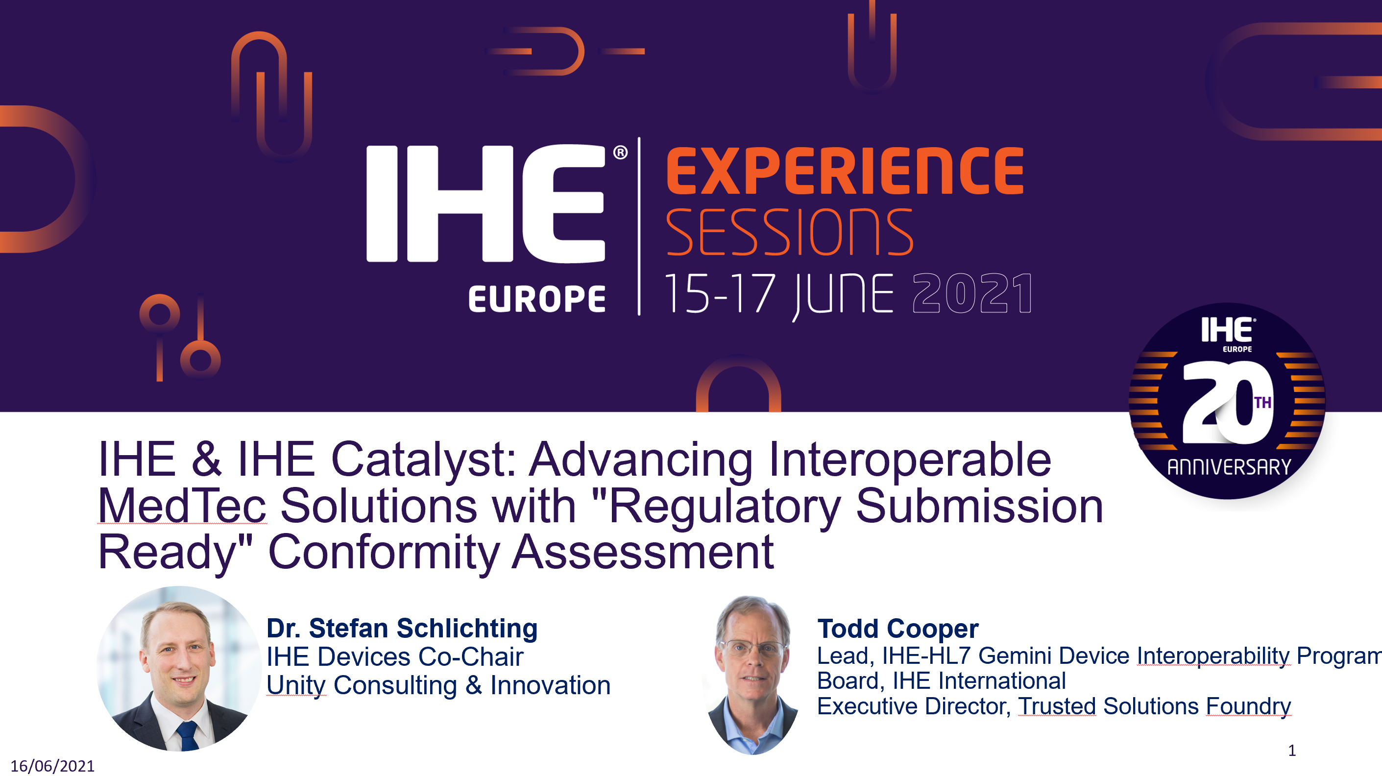
More detail is provided in …

Slide 96
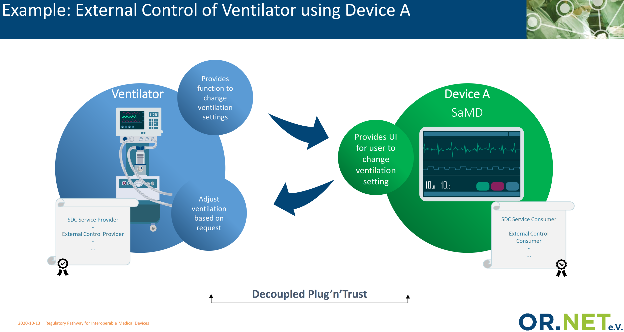
MedTech Regulatory Pathway – Core to SDC/SDPi Specifications

Slide 97
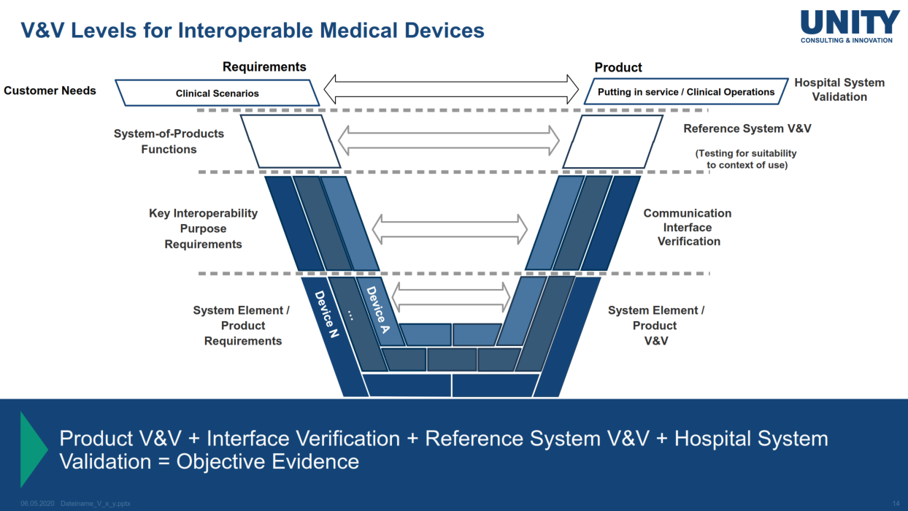
V-Model for Systems of MedTech Products
See IHE EU Experience ’21
… “Regulatory Submission Ready” CA

Slide 98
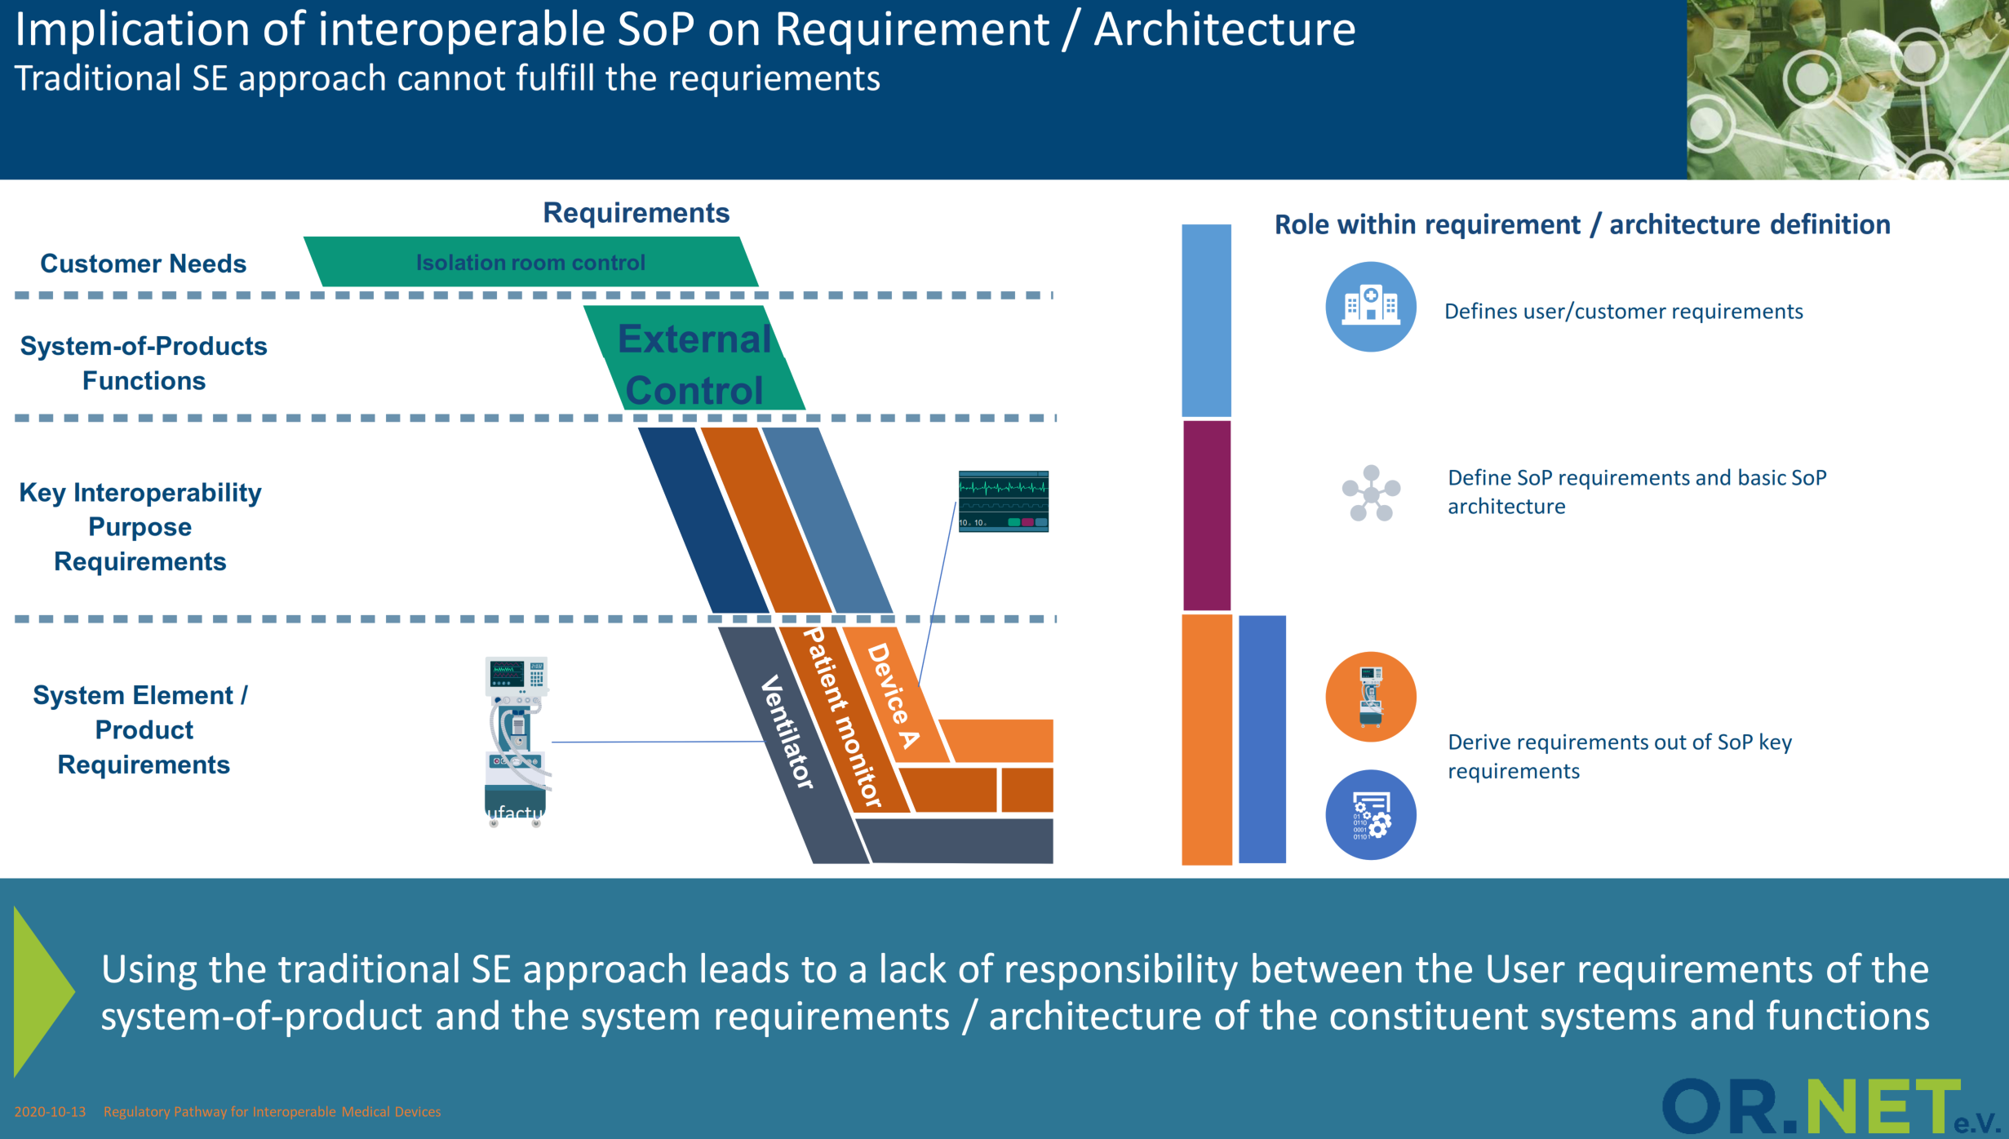
MedTech Regulatory Pathway – Core to SDC/SDPi Specifications

Slide 99
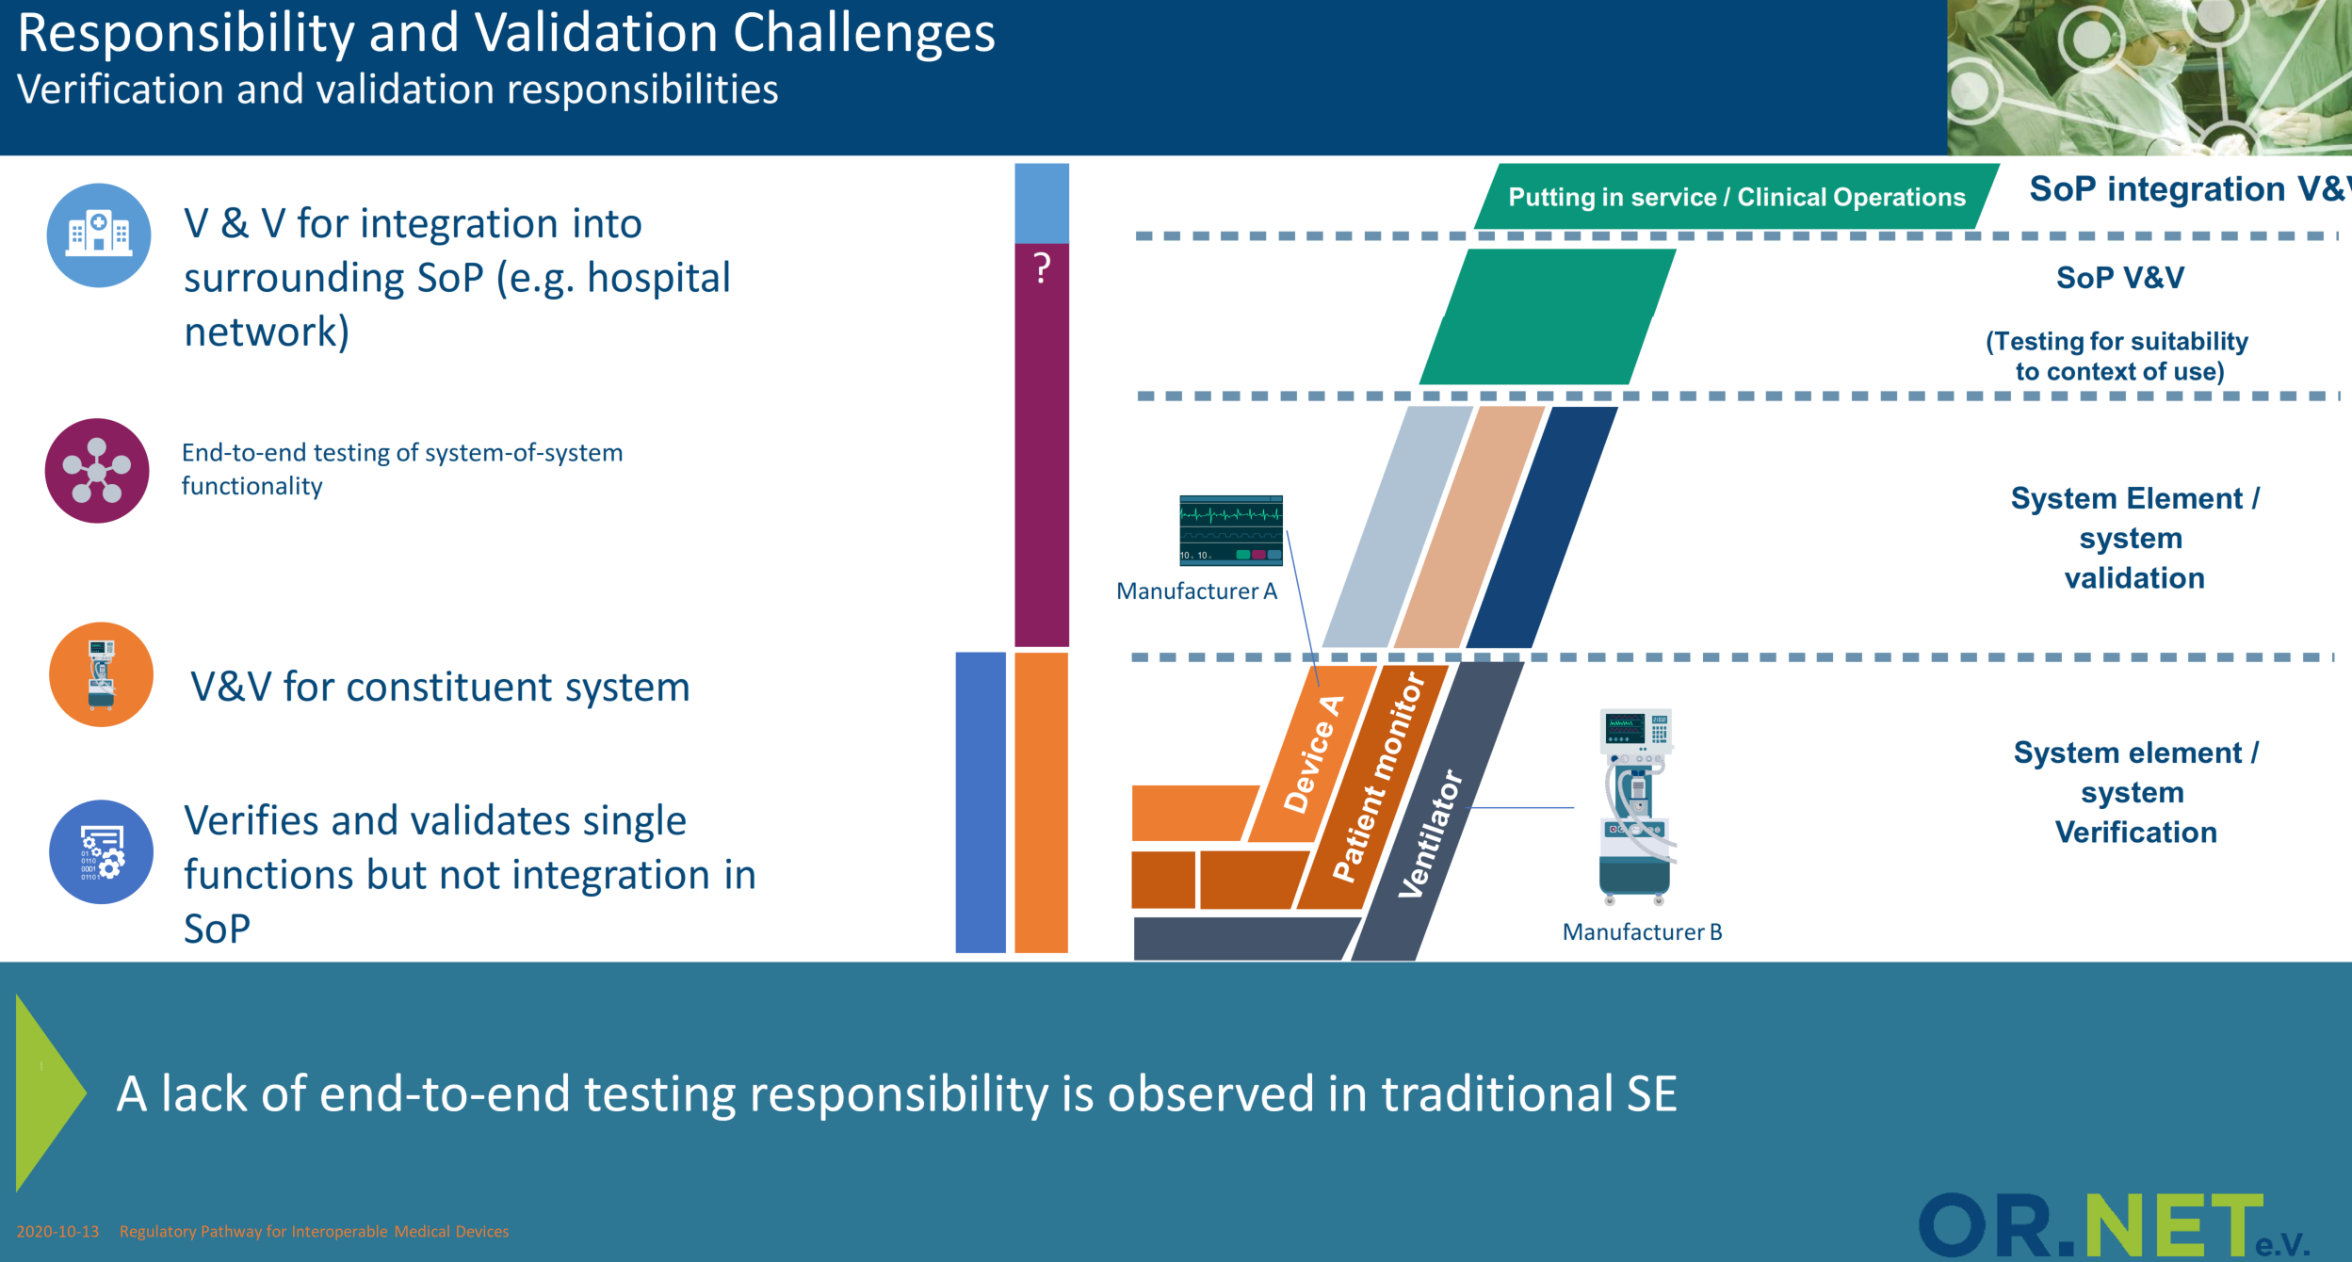
MedTech Regulatory Pathway – Core to SDC/SDPi Specifications

Slide 100

MedTech Regulatory Pathway – Core to SDC/SDPi Specifications

Slide 101

MF’s musings … toward a layer model
1st – Human crafted (this need met by this capability) / consensus approved
Future – Support RI Component “assembly” automation

